Slide 1
Velocity vs. time graphs

Slide 2
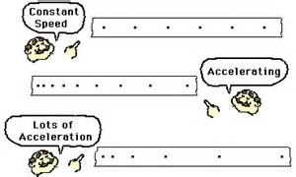
Ticker tape models

Slide 3
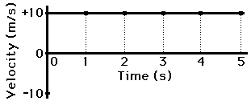
Constant velocity versus changing velocity

Slide 4
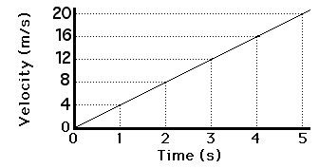
Changing velocity

Slide 5
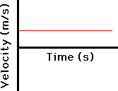
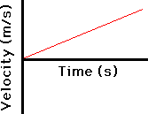
Positive velocity

Slide 6
What does the graph reveal
The slope of the line on a v/t graph reveals useful information about the acceleration of the object.
If a is 0 than the slope is 0 (horizontal line)
If a is + than the slope is +

Slide 7
Positive and negative velocity

Slide 8
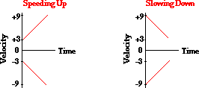
Speeding up and slowing down

Slide 9
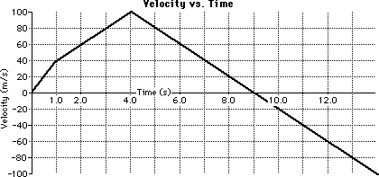
Meaning of the slope
In a time vs velocity graph the slope of the line = the acceleration of the object.
Analyze and calculate the motion of each stage of movement in this graph.

Slide 10
answers
First stage is +40m/s/s
Second stage is +20m/s/s
Third stage is -20m/s/s

Slide 11
Area on a vt graph
The area bound by the line and the axes represents the displacement of the object being measured.
Shape area review
Rectangle: Area = b*h
Triangle: Area = ½ * b*h
Trapezoid: Area = ½ * b * (h1 + h2)

