Slide 1
Vector Addition
Introduction to 2D motion and Forces

Slide 2
Methods of adding Vectors
Pythagorean Theorem
Head to Tail using a scaled vector diagram

Slide 3
Review of Pythagorean theorem
A^2+b^2=C^2
I leave home and drive 11 km North and then drive 11 km East. Determine my resulting displacement.
15.6 km.
1

Slide 4
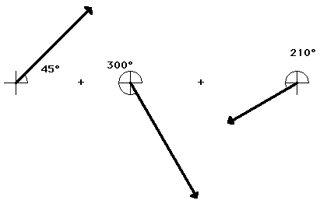
A Scaled head to tail diagram
Try to add these together.
Try to determine the direction of the resultant without using a protractor.

Slide 5
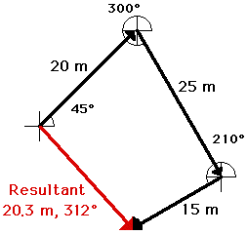
Resultant
The order doesn’t matter.
The resultant will always be the same.

Slide 6
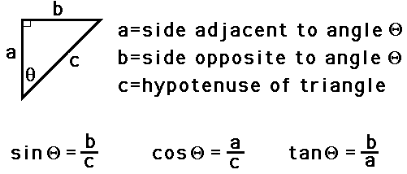
Using trig to determine a vector’s direction
Go back to my driving problem. Find the angle of theta.

Slide 7
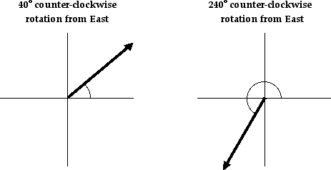
Vector direction
The direction of a vector is often expressed as an angle of rotation of the vector about its “tail” from east, west, north, or south.
The direction of a vector is often expressed counterclockwise angle of rotation of the vector about its “tail” from due East.

Slide 8
Vector Components
Transform a vector into two points with each part being directed along the coordinate axes.
Example: Northwest
North
West
A vector directed in two dimensions can be thought of as having an influence in two different direction.

Slide 9
Vector resolution
The process of determining the magnitude of a vector.
Two methods
Parallelogram method
Trigonometric method

Slide 10
Parallelogram method
1. select a scale and accurately draw the vector to scale in the indicated direction.
2. Sketch a parallelogram around the vector: beginning at the tail of the vector, sketch vertical and horizontal lines; then sketch horizontal and vertical lines at the head of the vector; the sketched lines will meet to form a rectangle.
3. Draw the components of the vector. The components are the sides of the parallelogram. The tail of the components start as the tail of the vector and stretch along the axes to the nearest corner of the parallelogram.
4. Label the components of the vectors with symbols to indicate which component represents which side.
5. Measure the length of the sides of the parallelogram and use the scale to determine the magnitude of the components in units. Label

Slide 11
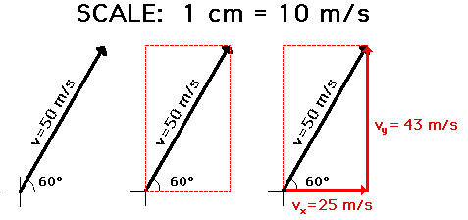

Slide 12
Trigonometric method
1. construct a rough sketch of the vector in the indicated direction. Label magnitude and the angle that it makes with the horizontal.
2. Draw a rectangle about the vector such that the vector is the diagonal of the rectangle.
3. draw the componenets of the vector. The components are the sides of the rectangle.
4. Label
5. To determine the length of the side opposite the indicated angle, use sine. Magnitude of vector=length of the hypotenuse.

Slide 13
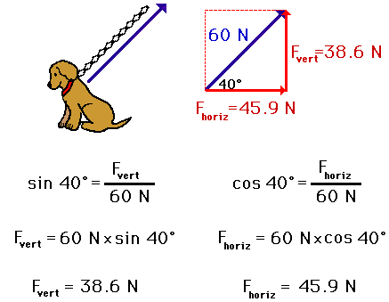

Slide 14
Addition of three of more right angled vectors
Red arrow = 6.0 Km, N
Blue arrow=6.0 km, E
Green arrow= 2.0 km, N
Try and determine the resultant displacement.

Slide 15
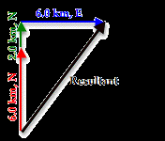
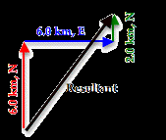
Answer

Slide 16
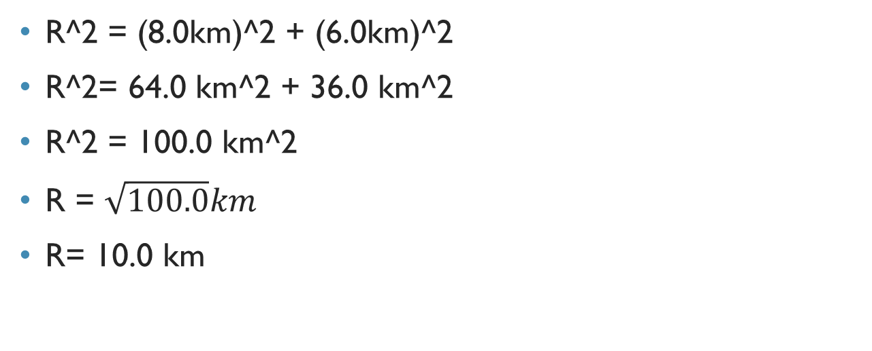
Answer continued
R^2 = (8.0km)^2 + (6.0km)^2
R^2= 64.0 km^2 + 36.0 km^2
R^2 = 100.0 km^2
R = $\sqrt{100.0}km$
R= 10.0 km

Slide 17
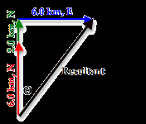
Now let’s find the direction
Which would you use to find the degree of theta?
- Sine
- Cosine
- Tangent

Slide 18
Answer continued
We would use Tangent.
Tangent = opposite/adjacent
Tangent (theta)= 6.0/8.0
Tangent (theta) = 0.75
Theta = tan^-1 (.75)
Theta = 37°

Slide 19
Tailwinds, headwinds, and river boat problems

Slide 20
Sample problems
Consider a plane traveling with a velocity of 100 km/hr, South that encounters a side wind of 25 km/hr, West. Now what would the resulting velocity of the plane be?

Slide 21
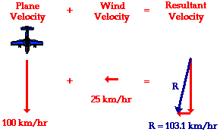
Answer

Slide 22
Riverboat question
If a motorboat were to head straight across a river (that is, if the boat were to point its bow straight towards the other side), it would not reach the shore directly across from its starting point. The river current influences the motion of the boat and carries it downstream. The motorboat may be moving with a velocity of 4 m/s directly across the river, yet the resultant velocity of the boat will be greater than 4 m/s and at an angle in the downstream direction. While the speedometer of the boat may read 4 m/s, its speed with respect to an observer on the shore will be greater than 4 m/s. The river current is 3.0 m/s. What is the resultant velocity and direction?

Slide 23
answer
(4.0 m/s)² + (3.0 m/s)² = R² 16 m²/s² + 9 m²/s² = R²
25 m²/s² = R²
SQRT (25 m²/s²) = R
5.0 m/s = R

Slide 24
Answer continued
tan (theta) = (opposite/adjacent) tan (theta) = (3/4)
theta = invtan (3/4)
theta = 36.9 degrees

