Slide 1
Types of force

Slide 2
Applied force
A force that is applied to an object by a person or another object

Slide 3
weight
The force with which object with mass attract one another.
All objects on Earth experience gravity “downward” towards the center of the Earth.
F(w)=m*g

Slide 4
Normal force
The support force exerted on an object that is in contact with another stable object
How to calculate normal force?
At rest
F(normal) = m * g

Slide 5
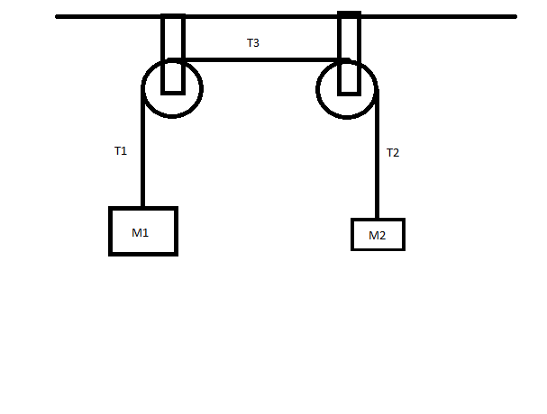
Tensional force
Tension force is the force that is transmitted through a string, rope, cable, or wire when it is pulled tight by forces acting from opposite end.
Tension force is stretched along the length of the wire and pulls EQUALLY on the objects on the opposite end of the wire.

Slide 6
friction
The force exerted by a surface as an object moves across it or makes an effort to move across it.
Friction results from the two surfaces being pressed together closely, causing intermolecular attractive forces between molecules different surfaces.
$F_{\left(f\right)}=μ⋅F_{N}$
Where mu represents the coefficient of friction.
There are two types of friction
Static Friction
Kinetic Friction

Slide 7
Static friction
F(s) : The type of friction that keeps an object “stuck” to a surface.
To get an object to move applied force must be greater than the force of static friction.
$F_{s}≤μ⋅F_{N}$

Slide 8
Kinetic friction
Kinetic friction: the frictional force that tries to stop an already moving object.
Kinetic friction is almost always less than static friction.
$F_{s}=μ×F_{n}$

Slide 9
Why do you care (or why should you care)?
These forces control everything that you do!
Knowing how friction behaves and what can affect it can enable you to drive better, ski better, play sports better.
Why?

Slide 10
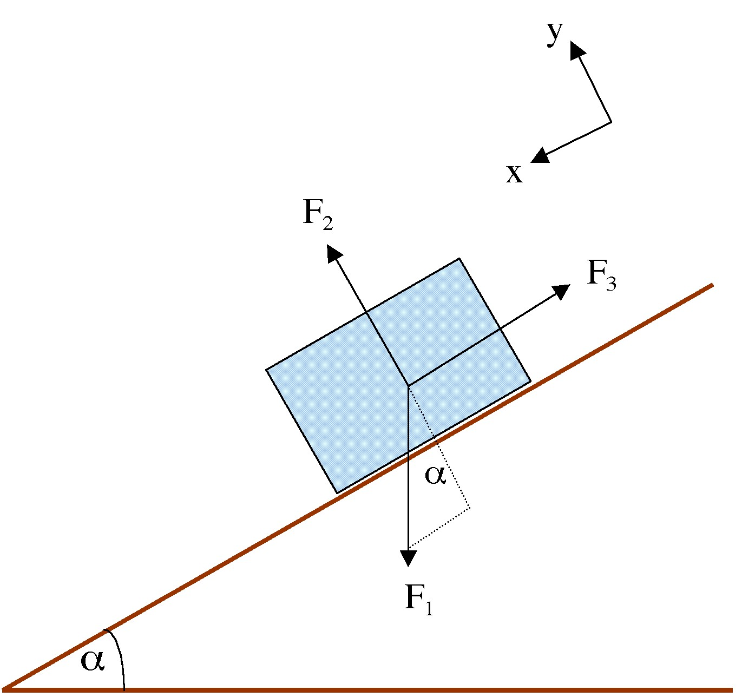
How do I represent forces?
Free-body diagrams!

Slide 11
How to determine net force
Unbalanced force = a force that does not become completely balanced by the other individual forces.
Calculating or realizing that there is a difference in forces, this causes motion.

Slide 15
Calculate the net force of each situation.

