Slide 1
Standing waves and wave behavior

Slide 2
What is a standing wave and how does it form?
A vibration of a system in which some particular points remain fixed while others between them vibrate with the maximum amplitude.
In a bounded medium, meaning where the medium is finite, standing waves are produced by any two identical waves traveling in opposite direction that have the right wavelength.
Correct wavelength meets its reflection.
The interference creates the wave that does not appear to move.

Slide 3
Standing Waves (cont.)
Require energy to be fed into the system at an appropriate frequency.
Driving frequency equals its natural frequency
THIS is RESONANCE!
Resonance can be identified by a dramatic increase in amplitude.

Slide 4
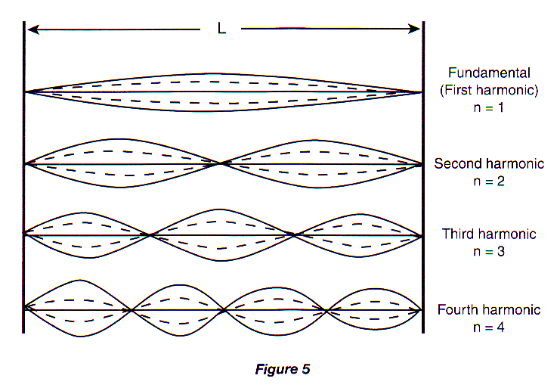
The Wavelengths with Two Fixed Ends

Slide 5
The first fundamental has two nodes at the ends and one antinode in the middle. This is ½ of a wave, therefore the length or L = 1/2λ.

Slide 6
The second harmonic or n=2 consists of 2 antinodes and 3
nodes.
We can see that this is a whole wave (2 antinodes to every wave)
by tracing it.
L= 2/2 λ
If the fundamental wavelength (last slide) had a 1m wavelength
the second harmonic (this slide) would be what?
½ m

Slide 7
Figure the length for the third and fourth harmonic?
1/3 m
¼ m

Slide 8
How do we determine the frequency of harmonic standing waves?
Frequency is inversely proportional to wavelength.
Frequencies of the harmonics are whole-number multiples of the fundamental frequency!
If the fundamental frequency were 1 HZ the frequency of the second harmonic would be 2 Hz, the third would be 3Hz, the 4th would be 4Hz.

