Slide 1
Sound: Unit 3
10/04/2016

Slide 2
Objective:
I can present and peer review group projects.
TASKS:
Sound presentations

Slide 3
Question:
What is a close-end resonator? (from presentations yesterday)

Slide 4
Announcements:
If you would like some help before a retake I am available 2nd, 4th, lunch (except Thursdays) and part of 7th.
Hat day tomorrow to support Mr. Tuss! Minimum donation of 1.00 for a sticker!

Slide 5
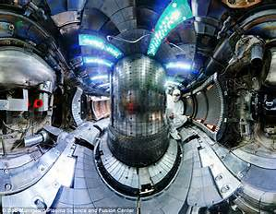
Current Event in Science:
Scientists have Broken a New Nuclear Fusion Record!

