Slide 1
One Dimensional Motion
Foundation

Slide 2
Reference Frames
A point from which a situation is observed.
Example:
Watching a train from your car at a crossing vs. watching from the train.
If a ball were thrown from a person on the train, it would look different depending on which frame of reference you are on. A second person on the train would see the ball go up and down (as if the two people were stationary). A person on a platform would see the people and ball moving horizontally at the speed of the train. The ball would make an arc.
Each perspective give a different view of the situation.

Slide 3
Distance and Displacement
How Far Will you Go?

Slide 4
Distance
The length traveled
Scalar quantity
What is a scalar quantity?

Slide 5
Displacement
The straight line from the starting point to the ending point.
Displacement can be negative (if you move backwards)
$Δ_{x}=x_{f}−x_{i}$
Where Δx is the displacement
Xf is the final position
Xi is the initial position.

Slide 6
Example

Slide 7
Displacement Example:
1) you start at 20 cm and got to 80 cm.
What is the distance traveled?
What is the displacement?
Distance = 60 cm traveled
Displacement=60 cm (notice it is positive so it denotes direction)
2) You start at 120 m and end at 80 m.
What is the distance traveled?
What is the displacement?
Distance = 40 m
Displacement = -40 m (notice it is negative so it denotes direction)

Slide 8
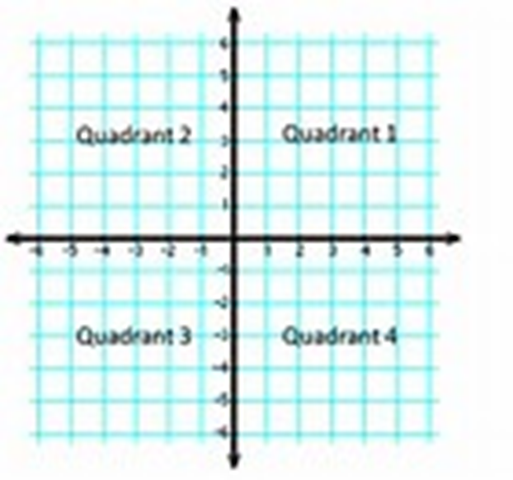
Conventions
In this class we will assume that right and up are positive and left and down are negative.

Slide 9
Speed and Velocity
How Fast?

Slide 10
Speed
How fast and object is moving
Scalar quantity
Can have varied units
Has no direction

Slide 11
Velocity
How fast an object is moving in a certain direction.
Vector quantity
Common units:
m/s
Mph
Any distance divided by time will do
$v={Δd}/{Δt}=\frac{ⅆ_{f}−ⅆ_{i}}{t_{f}−t_{i}}$
D = distance
T = time
Can be positive or negative

Slide 12
Velocity Examples
A person walks 4 m/s
Speed or velocity?
A person walks 2 m/s north
Speed or velocity?
A car drive 60 mph toward Butte
Speed or velocity?
A car drives 30 mph
Speed or velocity?
A 14 Newton for pull 30 degrees left of north.
Vector or Scalar?
A boat is pulled by a 53 Newton force
Vector or Scalar?

Slide 13
Instantaneous Speed VS Average Speed

Slide 14
Average Speed
Just like any other average.
Average speed = total distance/ total time
You walk 4 miles in 2 hours, than 3 miles in 2 hours, then stop for an hour. You then walk for another 3 miles in I hour. What was your average speed?
10 miles/6 hours
Average speed = 1.667 mph
On your way to Grandmother’s house, you drive 40 km in 45 minutes. You stop at a roadside rest for 15 minutes. Then you get on the freeway, driving 60 km in one hour. What was your average speed?
100 km/ 2 hours
Average speed = 50 kmph

Slide 15
Instantaneous Speed
A velocity at a particular instant.
Your speedometer is an instrument that shows this.
In the examples of average speed each individual portion of the journey could be seen as an instantaneous speed.
To find this on graph take two adjacent points on a graph, the use the velocity equation for those two points.
Or a tangent of a point on a graph.

Slide 16
Sample Problem:
Find the average speed and the average velocity of the skier during these three minutes.

Slide 17
Solution
The skier has an average speed of: (420 m)/ (3 min) = 140m/min
Average velocity of: (140 m, right)/ (3 min) = 46.7 m/min right

Slide 18
Acceleration

Slide 19
Acceleration
How fast your speed changes
Units are m/s²
Think of a car “speeding up”. It is accelerating. A car accelerating from 0 to 60 mps in 5 secs has a Δv of 60 meters/second and a Δt of 5 secs.
So a (acceleration)= 60 m/s/5 sec = 12 m/s²
$a=Δ_{v/{Δt}}=\frac{v_{f}−v_{i}}{t_{f}−t_{i}}$
Has direction and magnitude
Can have negative acceleration.

