Slide 1
Newton’s first law of motion and forces

Slide 2
What is force?
Any push or pull.
Force is measured in Newtons.
Forces are vectors.
Forces can change an object’s speed, direction, or position.

Slide 3
Different Types of Force.
There is the Force…

Slide 4
Contact vs. Action from afar Forces.
Contact forces
Those types of forces that result when two interacting objects are perceived to be physically contacting each other.
Forces Include
Frictional forces
Tensional forces
Normal forces
Air Resistance
Applied Forces

Slide 5
Action From Afar Forces:
Those forces that result even when two interacting objects are not in physical contact with each other, yet can exert a push or a pull despite their physical separation.
Examples:
Gravitational force
Electrical force
Magnetic force

Slide 6
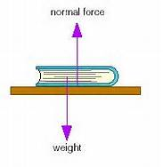
Normal Force:
The force of a surface acting on an object.
Always perpendicular to the plane of contact
Directly related to gravity.

Slide 7
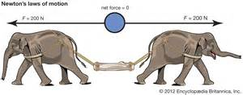
Balanced Force:
All forces acting upon an object equal, thus causing no change in position, speed, or direction.
This is also known equilibrium. If forces are equal and opposite direction.
No acceleration
at constant velocity

Slide 8
Unbalanced Forces
Anything that changes its state of motion is under the influence of unbalanced forces!
No continued force is needed to keep an object in motion under constant velocity.

Slide 9
Net Force:
The RESULT of all of the forces acting on an object. There can be many forces, but the object only reacts really to one force, net force.
$F_{Ne_{+}}=\sum{F}$
$\sum{F}=F_{1}+F_{2}…$

Slide 10
Examples:

Slide 12
Newton’s First Law of Motion
An object at rest will remain at rest and an object in motion will stay in motion at constant speed and in a straight line unless acted on by an unbalanced net force. Or is the there is no net force the object will continue at constant velocity.
Also known as the Law of Inertia.

Slide 13
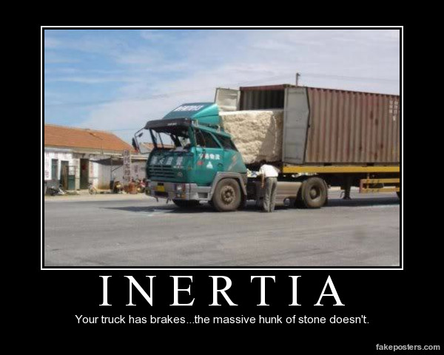
Inertia
The tendency to not change motion.
ONLY dependent upon the object’s mass (kg)
The higher the mass the higher the inertia or the higher the tendency to not change its motion.

