Slide 1
Light Basics

Slide 2
What is light?
Light as a Wave
Light can be seen having properties of a wave
Destructive interference
Reflection
Refraction
Diffraction
Doppler effect
However…..

Slide 3
Light also behaves like a particle
Light can travel through a vacuum.
Waves can’t, as seen in the previous two units.
Light is emitted in “packets” called Photons.
Photons act as both waves and particles in wave-particle duality.

Slide 4
Speed of Light
Light is given the constant C. You can see this in the famous equation of E=mC^2.
C=3 x 10^8 m/s
So far, we have found nothing that can travel faster than the speed of light.

Slide 5
Origin of Light
Photons are generated from electrons moving from higher orbitals to lower orbitals.
Each element has a different atomic make up. This allows us to determine a star and/or planets chemical makeup through spectroscopy.

Slide 6
Spectroscopy and Planck’s Constant
Spectroscopy is based upon the fact that ALL atoms and molecules absorb and emit light at certain wavelengths.
A spectrometer is an instrument that spreads out light and displays it for study. Light enters a narrow slit and passes through a lens that creates a beam of parallel rays.
The rays travel through a prism, which bends the light.
A second lens focuses the light on an exit slit, which allows one color of light to pass through at a time.

Slide 7
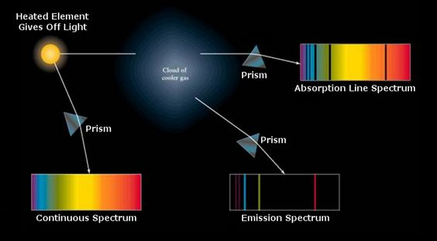

Slide 8
Planck’s Constant
(denoted as h) is the physical constant that is used to describe the sizes of quanta…what?
It was names after Max Planck.
It helped play a central role in quantum theory.
However, it can me used in measuring energy emitted by light photons.
E=hf
E-energy
H-Planck’s Constant
f-frequency.
The value of Planck’s constant is 6.626068 x 10^(-34) Joule seconds.

Slide 9
The Visible Light Spectrum

Slide 10
Visible Light
A prism (like a raindrop) can disperse white light into the visible light spectrum.
ROY G BIV
Each different color has a different wavelength.
As we know different wavelengths bend differently. When passed through the double refraction of a prism we can see the colors.
The Science of Rainbows
Part 1
Part 2

Slide 11
Energy of the Visible Light Spectrum
Red light as the lowest energy
Violet the highest of the colors
However, the visible light with the most energy is white light as it combines all of the colors.

Slide 12
The Electromagnetic Spectrum

