Slide 1
Inverse Square Law
In Light

Slide 2
What is the Inverse Square Law
An increase in one variable always causes another measurable quantity to decrease.
In the case of light, as the distance increases the illuminance decreases, and vice versa.

Slide 3
How Does Light Behave?
When Light is emitted does it move from its source in only one direction? Or does it move from its source in all directions, like a sphere?
Sphere
The inverse square law in light demonstrates that the intensity of the light away from its source is inversely proportional to the distance of the measured intensity from the source.

Slide 4
Quantity of Light
Lumen (lm): is the SI unit of luminous flux.
Luminous Flux: A measure of the perceived power of light. This is weighted according to the model of the human eye’s sensitivity to different wavelengths.
Pointance: The power (flux) of light per unit angle. Could also be called the intensity.

Slide 5
What is the difference between a lumen and a Watt?
What is a Watt?
It is the SI unit of Power and is defined as Joule per second.
What is a Lumen?
Measurement of the perceived “brightness” of a light source.
We used to compare Wattage when buying lightbulbs. In incandescent light this was a relatively good call because the Power used usually meant a brighter bulb and vice versa.
However, we now have LED’s and other bulbs. We should now pay more attention to lumens as the bulbs have a smaller power to output ratio.

Slide 6
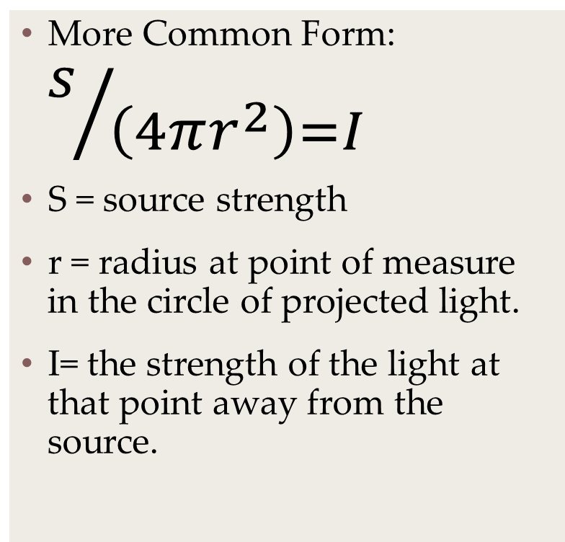
The Math
One form (when you have two distances and one lumen measurement):
E2 = (d1/d2)² x E1
E2 = the source strength at d2.
D1 = distance 1
D2 = distance 2
E1 = source strength at d1.
More Common Form: $s/{\left(4πr^{2}\right)=I}$
S = source strength
r = radius at point of measure in the circle of projected light.
I= the strength of the light at that point away from the source.

Slide 7
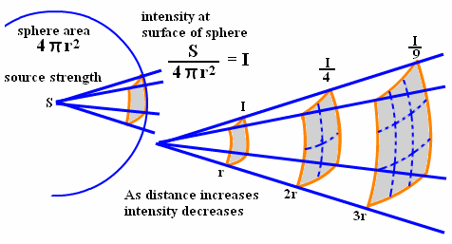

Slide 8
Sample Problems:
A light with the strength of 170 lm/m^2 ( was measured at .5 m and then calculated again 3 meters from the source. What is the luminous flux of the new calculation?
What does the equation look like when we put all of the data in for the variables?
Try to solve.

Slide 9
Example 1 continued:
S = 170 lm
r = 3 m
170 lm / 4π3²
= 4.72 lm

Slide 10
Example 2:
At a distance of 4.5 the readings of luminous flux is 80 lm. At a distance of 1 meter the luminous flux would be what for the same source?
E2 = (( 4.5 m/1)² x 80 lm.)
What is E2?
1.62e3 or 1620.0 lumens

