Slide 1
How air temperature affects the speed of sound
And a little Doppler effect

Slide 2
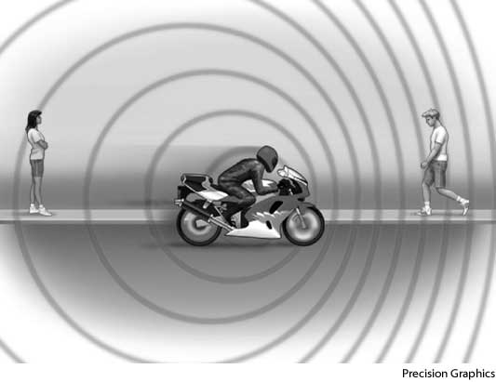
Video on Doppler Effect

Slide 3
Why does air temp. affect the speed of sound?
Heat is a form of kinetic energy.
Molecules at higher temperatures have more energy, thus, they can vibrate faster.
Since the molecules can vibrate faster, sound waves can travel more quickly.

Slide 4
Equation to calculate speed of sound in air with different temperatures.
V=331 m/s + 0.6m/s/C * T
Where T is the temperature of the air in Celsius.
Note: this does not take into account humidity and air pressure.

