Slide 1
freefall

Slide 2
TRUE FREE-FALLING OBJECTS
FREE-FALLING OBJECTS DO NOT ENCOUNTER AIR RESISTANCE.
ALL FREE-FALLING OBJECTS (ON EARTH) ACCELERATE DOWNWARDS AT A RATE OF 9.8 M/S/S

Slide 3
VELOITY AND TIME OF A FREE-FALLING OBJECT BEING DROPPED FROM REST
Time (s) | Velocity (m/s)
0 | 0
1 | - 9.8
2 | - 19.6
3 | - 29.4
4 | - 39.2
5 | - 49.0

Slide 4
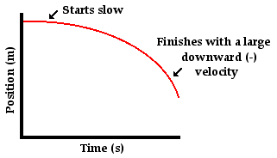
REPRESENTING FREE FALL BY GRAPHS
POSITION VS. TIME GRAPH
What does the curved line represent?

Slide 5
Velocity-time graphs

Slide 6
Dropped from rest
V(f) = g * t
d=.5 *g*t^2

Slide 7
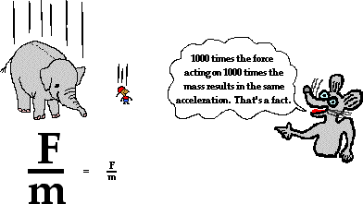
Why do all free falling objects fall at the same rate?
The acceleration of an object is directly proportional to force and inversely proportional to mass.
Increasing force tends to increase acceleration while increasing mass tends to decrease acceleration.

