Slide 1
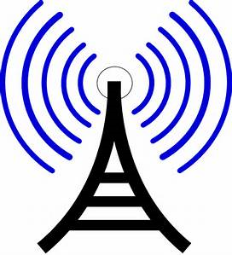
Radio Waves
-Longest wavelength of the electromagnetic spectrum
-Can easily pass through air and many solids.
-Ionosphere reflects radio waves. We use this to bounce radio waves around the Earth.
It is used for transmitting radio and television programs across long distances.
- There are no known harzards.

Slide 2
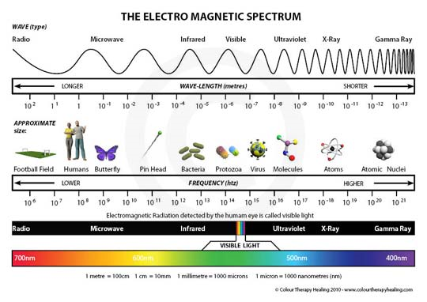
Electromagnetic Spectrum

Slide 3
Microwaves
3 cm to 1 inch long wavelength
Can pass through air, and can pass through earth’s atmosphere.
Used for cooking food, sending signals to and from satellites, mobile phones (sends signals between phones and antennas).
Hazards; can cause heating of body tissues.

Slide 4
Infrared Waves
Can easily penetrate air, but are stopped by most solids. However, the can penetrate glass (sun’s heat through a car windshield)
Used for: night vision, security systems, and remote controls.
Hazards: absorbed by skin, which then heats up. Too much infra-red radiation could give you skin burns.

Slide 5
Visible Light Waves
Wavelength from 0.0004mm to 0.0007mm.
What blocks visible light?
What can it be used for?
No known hazards.

Slide 6
Ultraviolet Waves
Wavelength = 0.00001mm to 0.0004mm
UV cannot pass through most solid materials.
Can easily pass through air, except the ozone layer. Some UV makes it but the ozone blocks the majority.
Used in:
Tanning Beds
Detecting forged bank notes
Security Coding.
Hazards: It is quite dangerous. Skin will burn due to prolonged exposure. Too much can lead to cancer. Eye damage can also occur due to much UV radiation.

Slide 7
X-Rays
Wavelength = very short. They are a type of ionizing radiation. Which means radiation that can actually change the stuff that objects are made of.
X-Rays pass through air, low density solids (body tissue). They are partially stopped by bone and thin metal.
Uses: X-ray machines.
Hazards: Too much exposure can damage the cells in your body, and may result in later cancer.

Slide 8
Gamma Rays
Wavelength: Shortest wavelength of all EM waves. Also have the highest energy. Not many things emit gamma radiation, but some radioactive materials do. Some extreme space objects do as well, like a supernova.
Most penetrating of all EM radiation. It can pass straight through your body.
Uses:
Sterilizing food and medical equipment.
Treatment of cancers. Cancer cells can be killed by gamma rays. However, gamma rays also kill healthy cells, so treatment has to be carefully designed to target cancer cells only.
Hazards: Reasonably safe in low doses, as they pass straight through your body without being absorbed much. However, high exposure can kill living cells.

