Slide 1
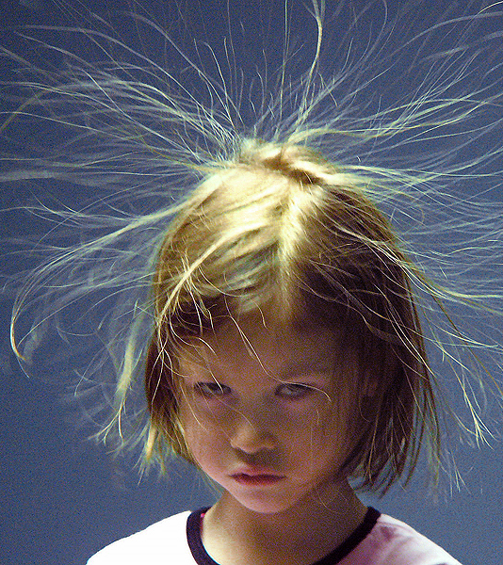
Electrostatics
It’s SHockING…
(I Know it is bad, but I can’t help it)

Slide 2
The structure of matter
Without electrostatics life as we know it would be impossible.
1
Electrostatic forces (attractive and repulsive) are what hold atoms and molecules together. Without it material items would not exist.
2

Slide 3
Our view of the atom
Our idea of the atom has evolved and will continue to evolve.
What does this have to do with electrostatics?

Slide 4
The atom and electrostatics
The nucleus of the atom contains positively charged protons and neutral neutrons.
These are not removable or perturbable by usual everyday methods.
It requires some form of high-energy nuclear occurrence.
Electrons are often removed from and added to an atom by normal everyday occurrences. This is where static electricity come from!

Slide 5
Neutral vs charged objects
Electrically Neutral: An atom contain equal numbers of protons and electrons
Ion: unequal number of protons and electrons
Positively Charged: Any particle, whether an atom, molecule or ion that contains less electrons than protons.
Negatively Charged: Any particle that contains more electrons than protons.

Slide 6
Charge as a quantity
The charge possessed by an object is often expressed as the Coulomb (C).
Who was Coulomb?
1 Coulomb
-1 C = 6.25 x 10^18 excess electrons
+1 C = 6.25 x 10^18 shortage of electrons
1 electron = -1.6 x 10^-19 C
1 proton = +1.6 x 10^-19 C

Slide 7
How to determine the charge
Electrically neutral objects will have a balanced proportion of electrons to protons.
To determine charge on a charged object (atom, molecule) we determine the total number of electrons and compare them, to determine the difference between the number of protons and electrons.
Multiply the difference by 1.6 x 10^19

Slide 8
Charge interactions
Charged objects have electric force.
Guess what?
OPPOSITE CHARGES ATTRACT!
LIKE CHARGES REPEL!

Slide 9
The electric force and newton’s third law
Newton’s third law is as a simple a mutual interaction between two objects that results in an equal and opposite push or pull upon those objects.
The electric force is a force and therefore behaves and follows the rules like one.
i.e. opposite charges attract and like charges repel.

Slide 10
Interaction between charged and neutral objects
What type of interaction will be observed between a charged object and a neutral object?
ANY charged object will have an attractive interaction with a neutral object.
This too is in accordance with Newton’s third law, or Newton’s law of action-reaction.

Slide 11
Conductors and insulators
Conductors:
Materials that permit electrons to flow freely from particle to particle.
A CONDUCTOR will permit charge to be transferred across the ENTIRE surface of the object.
If charge is transferred that charge quickly distributes across the entire surface of the object.
Distribution of charge is the result of ELECTRON movement.
A CONDUCTOR will distribute charge until the overall repulsive forces between excess electrons is minimized.

Slide 12
Conductors and insulators continued
Insulators:
Materials that impede the free flow of electrons from atom to atom and molecule to molecule.
If charge is transferred to an insulator at a given location, the excess charge will REMAIN at the initial location of charging.
Particles of an insulator do not permit the free flow of electrons; charge is seldom distributed evenly across the surface of an insulator.

Slide 14
HOW DOES CHARGE MOVE?
ELECTROSTATICS

Slide 15
Charge and electron movement
To predict the direction that electrons would move within a conducting material we need to apply the two rules of charge interaction.
WHICH WERE?
Example:
A negative charge is imparted at a location (excess electrons!)
Electrons have a personal bubble on a charged surface. They “want” to minimize the repulsive response to each other. So they migrate around the object (if it is a conductor)

Slide 16
continued
What happens if a conductor acquires an excess of positive charge?
Protons CAN’T move!
How can the excess positive charge distribute?

Slide 17
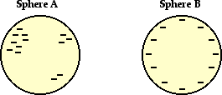
questions
One of these isolated charged spheres is copper and the other is rubber. The diagram below depicts the distribution of excess negative charge over the surface of two spheres. Which one is which?

Slide 18
questions
When an oil tanker car has arrived at its destination, it prepares to empty its fuel into a reservoir or tank. Part of the preparation involves connecting the body of the tanker car with a metal wire to the ground. Suggest a reason for why is this done.

Slide 19
Inducing charge
In conductors, electrons are so loosely bound that they can be INDUCED into moving from one section of the object to the another section.
To move an electron in a conductor all that needs to be done is to place a charged object next to the conductor.

Slide 20
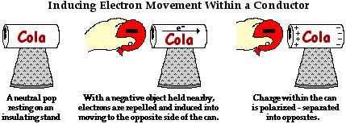
Polarization
When charges
(+ and -) have been separated from each other on an object.

Slide 21
Polarization continued
Always involves the use of a charged object to induce electron movement or rearrangement.
We already know what happens to a conductor but what happens to an insulator?
Electrons are not free to move across the surface of an insulator.
How can an insulator be polarized?

Slide 22
Polarization of an insulator
Electrons in an insulator redistribute themselves within the atom or molecule nearest the outer surface of the object.
Electrons are believed to be located in regions of space with specific sizes and shapes. The actual size and shape of these regions is determined by the high-power mathematical equations common to Quantum Mechanics.
For now we will refer to these locations as Electron Clouds.

Slide 23
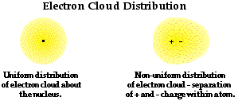
At any given point, an electron is likely to be found at some location within that cloud.
Electron clouds have varying density; where the cloud is the densest the higher the likelihood that the electron will be in that portion of the cloud.
Electron clouds are highly distortable.
Clouds are asymmetrical in shape for polarized atoms/molecules

Slide 24
Polarization is not charging
Polarization is simply a redistribution of the centers of positive and negative charges within the object.
Movement of electrons across the surface (CONDUCTORS)
Distortion of electron clouds (INSULATORS)
While there is a separation of charge, there is NOT an imbalance of charge.
When neutral objects become polarized, they are still neutral objects.

Slide 25
charging
Friction, induction, conduction and grounding

Slide 26
Electron affinity
Electron affinity: the relative amount of LOVE that a material has for electrons.
High electron affinity = lots of LOVE of electrons

Slide 27
Charging by friction
When you rub things together.
Example:
A balloon and a piece of animal fur are rubbed together.
During the rubbing process, the atoms of the rubber are forced into close proximity with those of the animal fur.
The electron clouds of the two types of atoms are pressed together and are brought closer to the nuclei of the other atoms.
The protons in the atoms of the material begin to interact with the electrons present on the other material.
Rubber atoms have a higher electron affinity. They take away electrons from the animal fur.
The two objects are now charged.

Slide 28
Triboelectric series
The ordering of materials according to their electron affinity.
Sample Series:
Celluloid
Rubber
Amber
Cotton
Human Skin
Silk
Rabbit Fur
Asbestos

Slide 29
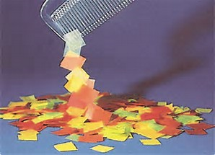
Law of conservation of charge
Charge is not created from nothing!
Total charge for all objects involved in charging does NOT change.

Slide 30
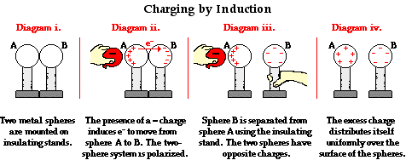
Charging by induction
Using a negatively charged object.

Slide 31
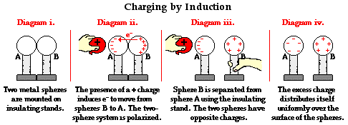
Using a positively charged object.

Slide 32
Grounding in induction charging
In induction electrons are not exchanged, just redistributed.
The second sphere in the previous picture is used to supply the electrons to sphere A or the receive electrons from sphere A.
This makes it the ground for the previous slide.

Slide 33
Ground
A large object

