Slide 1
Electric force
Only siths can use lightning.

Slide 2
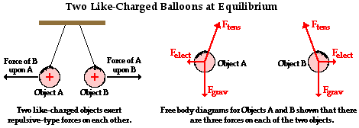
Charge interactions are forces
This picture shows how the interaction between wo charges results in a mutual force acting upon the charged object.
We can analyze electric force using a free-body diagram.
We know how to quantify gravitational force and frictional force how do we quantify electric force.

Slide 3
Coulomb’s law
The interaction between charged objects is a non-contact force that acts over some distance of separation.
Electric Force is a vector quantity. How do we know the direction of the force?
The magnitude of electric force is strongest when two objects are close together. The magnitude of the force and the distance between the two objects are inversely related.

Slide 4
THE EQUATION
The quantitative expression for the effect of:
Charge
Direction
Magnitude of Force
$F=\frac{k⋅Q_{1}⋅Q_{2}}{d^{2}}$
Q1=quantity of charge on object 1 (C)
Q2=quantity of charge on object 2 (C)
d=The distance of separation between the two objects (m).
k= The proportionality constant known as Coulomb’s Law Constant.

Slide 5
The coulombs law constant
k
The value of the constant is dependent upon the medium that the charged objects are immersed in.
Air has the approximate value of 9.0 x 10^9 N x m^2/C^2

Slide 6
What does coulomb’s law do?
Provides an accurate description of the force between two object whenever the objects act as point charges.
Key to remember: Charges can be positive or negative. This means that an object either has an excess or shortage of electrons. DO NOT USE + or – signs in the calculations of the force!

Slide 7
Coulomb’s examples
Determine the electrical force of attraction between two balloons with separate charges of +3.5 x 10^-8 C and -2.9 x 10^-8 C when separated by a distance of 0.65 m.
Step 1: Identify known values in variable form.
Q1 = +3.5 x 10^-8 and Q2 = -2.9 x 10^-8
D = 0.65 m
Step 2: Identify the requested value
F = ??
Step 3: Substitute and solve.
Answer: 2.16 x 10^-5 N, attractive

Slide 8
continued
Determine the electrical force of attraction between two balloons that are charged with the opposite type of charge but the same quantity of charge. The charge on the balloons is 6.0 x 10^-7 C and they are separated by a distance of 0.5 m.
Answer: 1.3 x 10^-2 N, attractive (rounded)

Slide 9
Another inverse square law!
The pattern between electrostatic force and distance is an inverse square law.
Row | Separation Distance | Electrostatic Force
1 | 20.0 cm | 0.1280 N
2 | 40.0 cm | 0.0320 N
3 | 60.0 cm | 0.0142 N
4 | 80.0 cm | 0.0080 N
5 | 100.0 cm | 0.0051 N

Slide 10
Electric Force and Acceleration
If an object were levitating due to electric force how would we calculate the acceleration?
01
We need to determine the net force!
02
To determine net force we find the force of gravity and the electrical force.
03
The net force is the vector sum of these two forces. Remember the different directions.
04
We then use Newton’s second law to determine the acceleration
05

Slide 11
Configurations of three or more charges
Electrical forces result from mutual interactions between two charges.
In three or more charge situations the electrical force on a single charge is merely the result of the combined effects on each individual charge interaction of that charge with all the other charges.
If a charge encounters two or more interactions, then the net electric force is the vector sum of those individual forces.

Slide 12
Example
Charges A and D are negative B and C are positive.
What is the net electric force acting upon charge A?
The forces of the other three charges must be calculated using Coulomb’s Law.
F_{BA} = k • Q_{A} • Q_{B} / d_{BA}²
F_{CA} = k • Q_{A} • Q_{C} / d_{CA}²
F_{DA} = k • Q_{A} • Q_{D} / d_{DA}²
Direction can be determined by applying the basic rules of charge interaction.
Draw the free-body diagram for charge A.

Slide 13
Electric field
Action at a distance force = field force (no physical contact)
A charged object creates an electric field- an alteration of the space in the region that surrounds it.
Other charges in that field would feel the unusual alteration of the space.
THINK VAN DE GRAAFF!

Slide 14
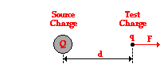
Electric field intensity
Electric field strength is a vector quantity.
Electric field strength = force/charge
E = F/q
q=the quantity of charge on the test charge (not the source charge)
Unit = Newton/Coulomb

Slide 15
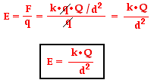
Another formula for electric field strength

Slide 16
The direction of the electric field vector
The force on the test charge could be directed either towards the source charge or away from it.
This depends upon the type of charge of both the test and the source.
A SCIENTIFIC CONVENTION:
A positive test charge is pushed or pulled when in the presence of the electric field.
Electric field vectors are always directed towards negatively charged objects.

Slide 17
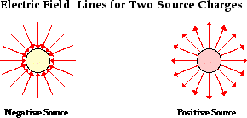
Electric field lines

Slide 18
Rules for drawing electric field patterns
1. objects with greater charge create stronger electric fields, thus they should be surrounded with more lines.
2. Density of lines at a specific location. Field lines are denser at locations closest to the surface of the charge and least at locations further from the charge.
3. Force lines are always perpendicular to the surface of the object.
4. Electric field lines should never cross.

Slide 19
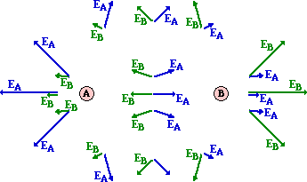
Electric field lines for configurations of two or more charges.
A and B are both positive charges.
At any given location surrounding the charges, the strength of the electric field can be calculated using the expression kQ/d^2.
The expression would need to be done twice at each location (using each charge)
The results of the calculations are in the picture.
Strength is given by the length of the arrow.
Direction is represented by the direction of the arrow.

Slide 20
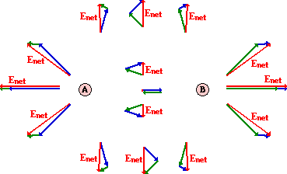
Showing the vectors that led to the resultant vector

Slide 21
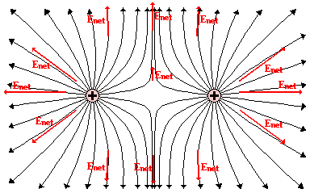
Drawing the field lines

Slide 22
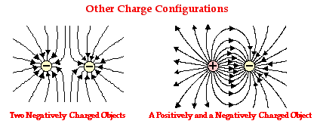
More configurations Pay close attention to the direction of the arrows for the charges.

Slide 23
The rules
Electric field lines always extend from a positively charged objects to a negatively charged object and vice versa.
Electric field lines never cross each other.
Electric field lines are most dense around objects with the greatest amount of charge.
At locations where electric field lines meet the surface of an object, the lines are perpendicular to the surface.

Slide 24
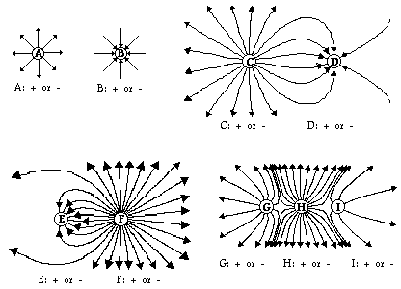
Examples (identify the charges)

Slide 25
Electric fields and conductors

Slide 26
Charged conductors
Charged conductors that have reached electrostatic equilibrium have unusual characteristics:
The electric field anywhere beneath the surface of the conductor is zero. (an electric field beneath the surface would exert a net force therefore not at equilibrium)
Huh?

Slide 27
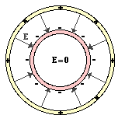
Two concentric, conducting cylinders of different radii.
Notice that the field lines would be directed toward each cylinder.
Does anybody know an application of this?

Slide 28
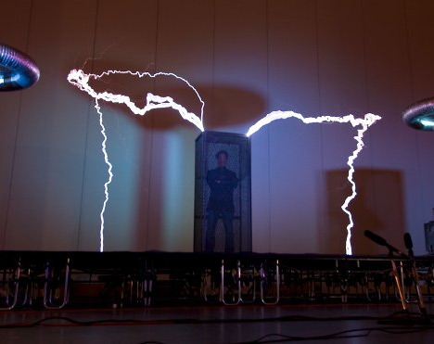
A faraday cage!
The cage shields whomever and whatever is on the inside from the influence of electric fields.
We use shielding to protect equipment.

