Slide 1
Color
And Light

Slide 2
What is Color?
Visual perception categorized by human properties.
If you walk into a dark room (completely dark) do you see any color?
NO!
Color is derived from the visual spectrum of light.
Red, Orange, Yellow, Green, Blue, Indigo, Violet
This is the smallest band of the electromagnetic spectrum.
Different wavelengths are perceived as different colors.

Slide 3
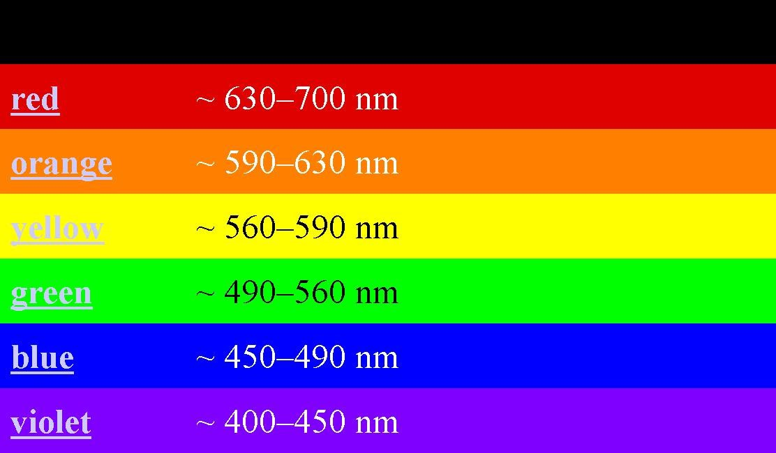
Visual Spectrum of the Electromagnetic Spectrum

Slide 4
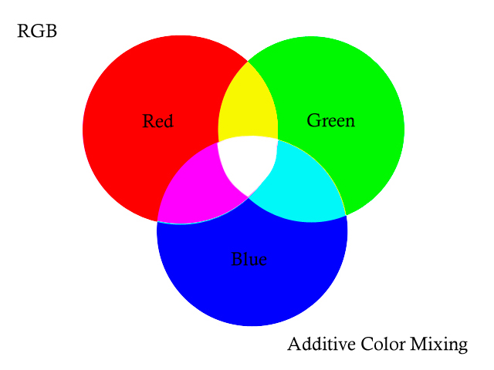
Primary Color
There are two different color models
Light Color Primaries
Additive Light color
These colors can be combined to make all other colors.
Used by computers and televisions (light sources)

Slide 5
Additive (Light) Color
Color is transmitted through transparent media
All colors added together = white.
The absence of light = true black
When Red, Blue, Green primaries are mixed evenly they create the secondary colors of the pigment colors, the next model.

Slide 6
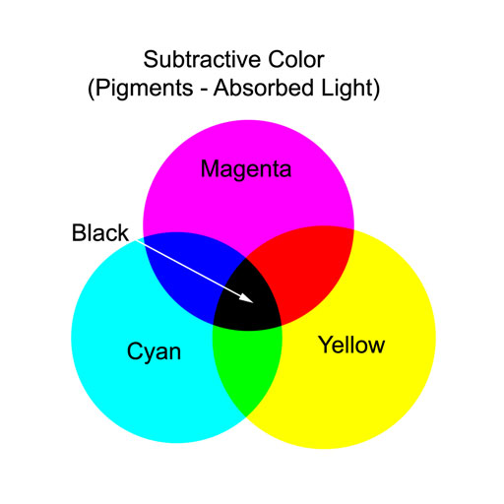
Pigment (subtractive) Model
Used when producing colors from reflected light, like a color printer.
Pigments are chemicals that absorb selective wavelengths, they prevent certain wavelengths of light from being transmitted or reflected.

Slide 7
Subtractive (Pigment) Model
These are ultimately derived from the primary colors.
The may reason we have this separate model is that all printable colors are derived from the cyan, magenta, and yellow.
Color is absorbed by and reflected off the media
All colors added together = black
To achieve true black, pure black has to be added, this makes the more recognizable title of CMYK, used in printing
(K = black)

