Slide 1
Circuits
I hope you are “open” to learning this material and have the “capacity” to internalize it…

Slide 2
What is an Electric Circuit?
Circuit: Simply a closed loop through which charges can continuously move.
Electricity is not just present in the “bulb” or resistor but throughout the whole circuit.

Slide 3
Requirements of a Circuit
A Closed Conducting Path
Must extend from the positive to the negative.
An Energy Supply
There must be an electric potential difference across the two ends of a circuit, like a battery.
How is energy produced in a battery?
Charge is moved from the low energy terminal (-) to the high energy terminal (+). Work is done on the charge to move it. The electrochemical cell provides the energy to do the work on the charge. This establishes and electrochemical difference across the two ends of the electric circuit.

Slide 4
Current
Current: the rate at which charge flows past a point in a circuit.
It is a rate quantity: some quantity over time, like velocity.
Current is the quantity of charge over time.
I =Q/t
Units: Ampere or Amp (A)
1 Amp = 1 Coulomb/1 second

Slide 5
Examples:
A 2mm long cross section of wire is isolated and 20 C of charge is determined to pass through it. What is the current?
0.5 Amps
A 1 mm long cross section of wire is isolated and 2 C of charge is determined to pass through it in 0.5 s. What is the current?
4 Amps

Slide 6
What direction does current flow?
All negatively charged electrons move in the direction opposite the electric field.
However, charge carriers can be positive, negative charges or both.
The Convention: You can thank Ben Franklin…The direction in which a positive charge would move is the direction of the flow. So, current in a circuit it directed AWAY from the positive terminal and toward the negative terminal.

Slide 7
POWER:
Power: The rate at which electrical energy is supplied to a circuit of consumed by a load.
Power= Energy consumed by load/time
P = ΔE/t
Unit: is watt (W) (I know same as work)
1 watt = 1 joule/second

Slide 8
What is a kilowatt-hour?
What Northwest bills us in.
A kilowatt is a unit of power and an hour is a unit of time.
Utility companies charge for using electrical energy.

Slide 9
Calculating Power:
Power is the rate at which energy is added or removed from a circuit by a battery or a load.
Current is the rate wat which charge moves past a point on a circuit.
Electric Potential Difference across the two end of a circuit is the potential energy difference per charge between these two points.

Slide 10
We Can Combine all Three Equations!

Slide 11
Examples:
Determine the ...
a. ... current in a 60-watt bulb plugged into a 120-volt outlet.
b. ... current in a 120-watt bulb plugged into a 120-volt outlet.
c. ... power of a saw that draws 12 amps of current when plugged into a 120-volt outlet.
d. ... power of a toaster that draws 6 amps of current when plugged into a 120-volt outlet.
e. ... current in a 1000-watt microwave when plugged into a 120-volt outlet

Slide 12
Answers:
A) 0.5 A
B) 1.0 A
C) 1440 W
D) 720 W
E) 8.3 A

Slide 13
Concepts
An electrochemical cell supplies the energy needed to move a charge from a low potential location to a high potential location
The charge that flows through a circuit originates in the wires of the circuit. The charge carriers in wires are simply the electrons possessed by the atoms that make up the wires
Charge moves abnormally slowly - on average, about 1 meter in an hour - through a circuit. Yet as soon as a switched is turned to ON, charge located everywhere within the circuit begins to move
The rate at which charge flows is everywhere the same within an electric circuit. The rate at which charge flows into a light bulb is the same as the rate at which charge flows out of a light bulb
An electrical appliance such as a light bulb transforms the electrical energy of moving charge into other forms of energy such as light energy and thermal energy. Thus, the amount of electrical energy possessed by a charge as it exits an appliance is less than it possessed when it entered the appliance

Slide 14
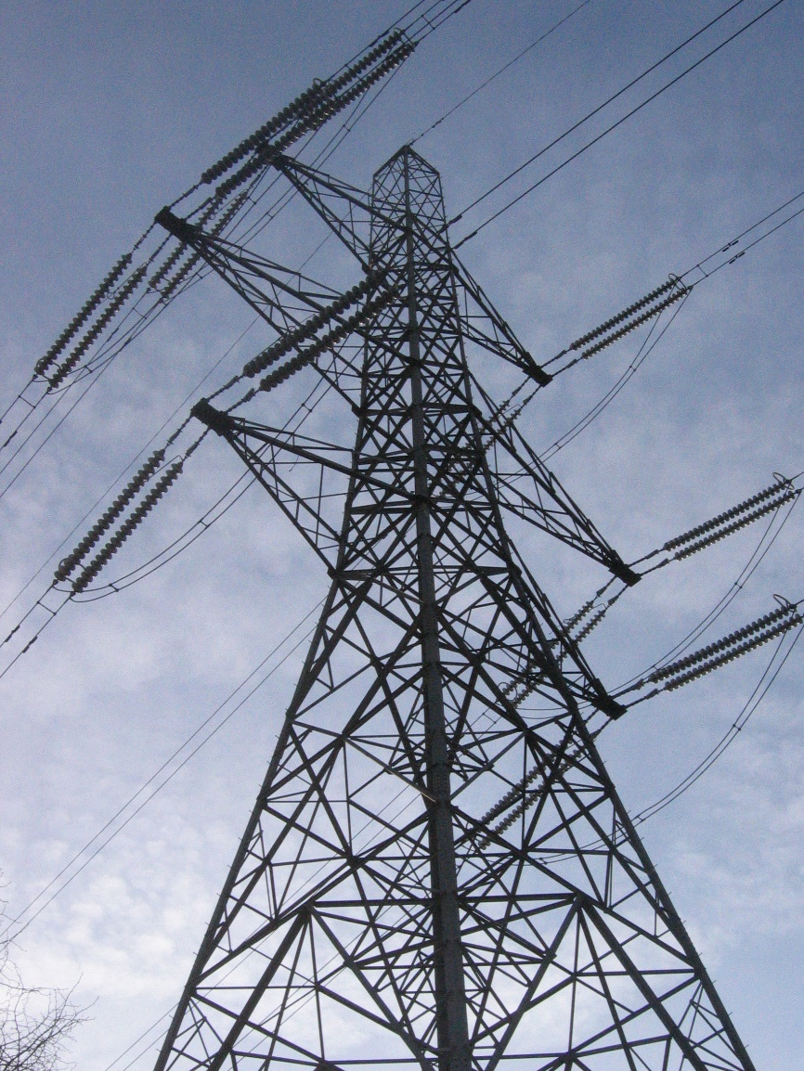
How does an Electron Move?
This Photo by Unknown Author is licensed under CC BY-SA

Slide 15
Go With the FLOW!
This Photo by Unknown Author is licensed under CC BY-NC-ND

Slide 16
Common Misconceptions
Batteries are not rechargeable
No charge is lost in a battery only the energy to move charge, as charge does NOT reside in a battery.
They supply the energy to move a charge from a low potential location to a high potential location.
Charge originates in the wires of the circuit, not the battery or source
“rechargeable” batteries rely on turning chemical products back into chemical reactants.

Slide 17
Resistance
The hindrance to the flow of charge.
What affects resistance?
The total length of wires. Longer wire = more resistance.
Cross-sectional area of the wires. Wider wire = more resistance.
Wire material. Higher resistivity = more resistance.

Slide 18
Resistivity of Common Materials
Material | Resistivity(ohm•meter)
Silver | 1.59 x 10⁻⁸
Copper | 1.7 x 10⁻⁸
Gold | 2.2 x 10⁻⁸
Aluminum | 2.8 x 10⁻⁸
Tungsten | 5.6 x 10⁻⁸
Iron | 10 x 10⁻⁸
Platinum | 11 x 10⁻⁸
Lead | 22 x 10⁻⁸
Nichrome | 150 x 10⁻⁸
Carbon | 3.5 x 10⁻⁵
Polystyrene | 10⁷ - 10¹¹
Polyethylene | 10⁸ - 10⁹
Glass | 10¹⁰ - 10¹⁴
Hard Rubber | 10¹³

Slide 19
Math of Resistance
Resistance is measured in Ohms and is represented by an Ω.
R = p (L/A)
p = resistivity of the material
L = Length of the wire (in meters)
A = Area of the wire (in meters ^2)

Slide 20
Ohm’s Law
ΔV = I • R
ΔV = the electric potential difference between two points in a circuit.
I = Current between those two points
R = total resistance of all electrical devices between those two points.

Slide 21
Seriously Potential Difference!
Potential Difference = VOLTAGE or the Volt

Slide 22
How to measure Current
Two common tools are used
Ammeter = used to measure current at a given location. It is placed in series.
Voltmeter = a device with probes that can touch to location on a circuit to determine the electric potential difference across those location. Not placed in series.

Slide 23
All in ONE place!
Quantity | Symbol | Equation(s) | Standard Metric Unit | Other Units
Potential Difference (a.k.a. voltage) | ΔV | ΔV = ΔPE / Q ΔV = I • R | Volt (V) | J / C
Current | I | I = Q / t I = ΔV / R | Amperes (A) | Amp or C / s or V / Ω
Power | P | P = ΔPE / t (more to come) | Watt (W) | J / s
Resistance | R | R = ρ • L / A R = ΔV / I | Ohm (Ω) | V / A
Energy | E or ΔPE | ΔPE = ΔV • Q ΔPE = P • t | Joule (J) | V • C or W • s

Slide 24
Questions:
A certain electrical circuit contains a battery with three cells, wires and a light bulb. Which of the following would cause the bulb to shine less brightly? Choose all that apply.
a. increase the voltage of the battery (add another cell)
b. decrease the voltage of the battery (remove a cell)
c. decrease the resistance of the circuit
d. increase the resistance of the circuit

Slide 25
Questions
Use the Ohm's law equation to provide numerical answers to the following questions:
a. An electrical device with a resistance of 3.0 Ω will allow a current of 4.0 amps to flow through it if a voltage drop of ________ Volts is impressed across the device.
b. When a voltage of 120 V is impressed across an electric heater, a current of 10.0 amps will flow through the heater if the resistance is ________ Ω.
c. A flashlight that is powered by 3 Volts and uses a bulb with a resistance of 60 Ω will have a current of ________ Amps.

Slide 26
Answer:
A) 12 volts
B) 12 Ohms
C) 0.05 Amps

Slide 27
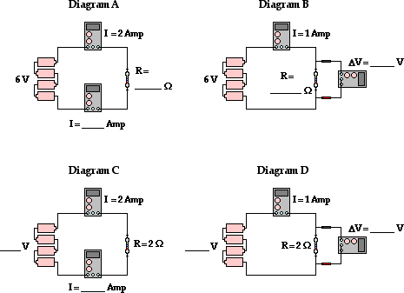
Question

Slide 28
Answer
A) R = 3 Ohms
I = 2 Amps (remember current is the same everywhere)
B) R = 6 Ohms
V = 6 Volts
C) V = 4 Volts
I = 2 Amps
D) V = 2 Volts

Slide 29
Circuit symbols and circuit diagrams

Slide 30
The Symbols

Slide 31
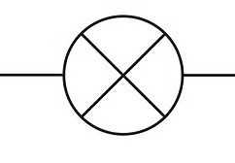
The lamp
Lamps or lightbulbs are resistors in circuits.
As such they can be represented with the resistor symbol or the lamp symbol below.

Slide 32
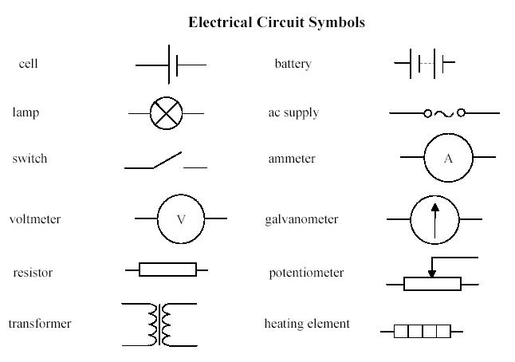

Slide 33
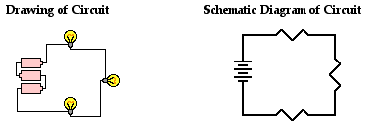
Drawing a Circuit vs. Schematic of a Circuit

Slide 34
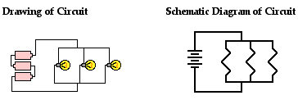
Series Circuit vs Parallel Circuit

Slide 35
Set up two circuits
Make a series circuit with three bulbs (resistors) Answer these questions
As the number of resistors increases, what happens to the overall current within the circuit?
As the number of resistors increases, what happens to the overall resistance within the circuit?
If on of the resistors is turned off (light bulb is loosened to go out) what happens to the other resistors in the circuit?
Make a parallel circuit with three bulbs and answer the questions again.

Slide 36
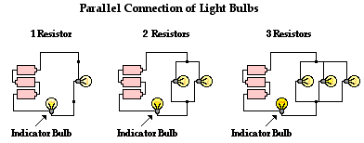
How to set up your Parallel Circuit

Slide 37
For a Series Circuit
The more resistors that are added the overall current within the circuit decreases (light bulbs get dimmer)
The decrease in current is consistent with the conclusion that the overall resistance increases.
If one of the three bulbs in a series circuit is unscrewed from its socket, then it is observed that the other bulbs immediately go out. In order for the devices in a series circuit to work, each device must work.

Slide 38
For a Parallel Circuit
As you add more resistors your indicator bulb should get brighter.
As the number of resistors increases, the overall current increases. This indicates a decrease in the overall resistance in the circuit.
If an individual bulb is unscrewed from its socket the remaining bulbs still work.

Slide 39
Why does this happen?
We can create an analogy between the flow of traffic in a tollway system to that of charge through a wire.
Tollbooths restrict movement like resistors do in a circuit.
Suppose we add more tollbooths to increase the flow of traffic. If we were to add them on the same street one right after the other what would happen?
Now what would happen if we placed them next to each other?

Slide 40
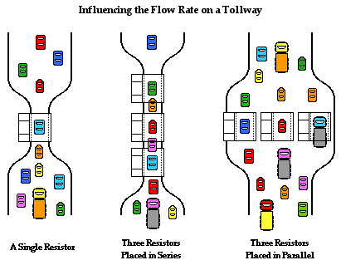

Slide 41
Series Circuits
Charge flows together through the circuit at a rate that is everywhere the same. There is no greater current at one location then at another location.
Equivalent Resistance: the amount of resistance that a single resistor would need in order to equal the overall effect of the collection of resistors that are present in the circuit.

Slide 42
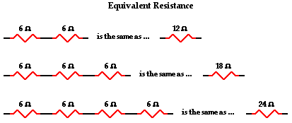

Slide 43
Equivalent Resistance in a Series Circuit
For a series circuit:
R(eq) = R1 + R2 + R3 + …

Slide 44
Charge in a Series Circuit
Charge does NOT pile up and being to accumulate at any given location.
Charge does NOT become used up by resistors such that there is less of it at one location compared to another.
Current: the rate at which charge flows
I (battery) = I1 + I2 + I3

Slide 45
Current Calculated
Current can easily be calculated if the voltage of battery is known and the individual resistance values are known.
REMEMBER OHM’S LAW!!!
I(battery) = I1 + I2 + I3 = ΔV (battery) / R(eq)

Slide 46
Electric Potential Difference and Voltage Drops
Voltage Drop: Occurs as the electrical energy of the charge is transformed to other forms of energy (thermal, light, mechanical) within the resistors or loads.
There is a voltage drop for each resistor, but the sum of these voltage drops is equivalent to the voltage of the battery.

Slide 47
So What?

Slide 48
Mathematical Analysis of Series Circuits

Slide 49
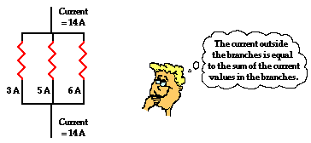
Parallel Circuits
Current: In a parallel circuit charge divides up into separate branches such that there can be more current in one branch than there is in another.

Slide 50
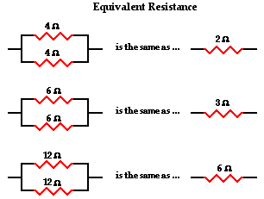
Equivalent Resistance

Slide 51
Equivalent Resistance Mathematically
In parallel circuits: 1/R(eq) = 1/R(1) + 1/R(2) + 1/R(3)…
Try it out…

Slide 52
Voltage Drop for Parallel Branches
Charge does not pass through every resistor; it passes through a single resistor.
The entire voltage drop across that resistor must match the battery voltage.
Vbattery = V1 = V2 = V3 =

Slide 53
Mathematical Analysis

Slide 54
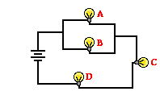
Combination Circuits

Slide 55
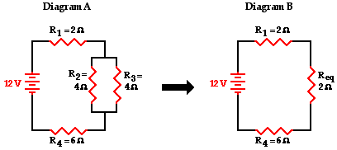
How do you solve?
Treat the Parallel circuit as one resistor and find the equivalent resistance.
Then add it back into the circuit to find the equivalent resistance for a series circuit.

Slide 56
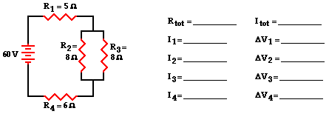
Give it a try

Slide 57
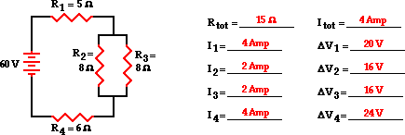

Slide 58
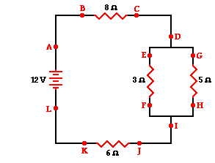
a. The current at location A is _____ (greater than, equal to, less than) the current at location B.
b. The current at location B is _____ (greater than, equal to, less than) the current at location E.
c. The current at location G is _____ (greater than, equal to, less than) the current at location F.
d. The current at location E is _____ (greater than, equal to, less than) the current at location G.
e. The current at location B is _____ (greater than, equal to, less than) the current at location F.
f. The current at location A is _____ (greater than, equal to, less than) the current at location L.
g. The current at location H is _____ (greater than, equal to, less than) the current at location I.

Slide 59
A) Equal
B) Greater Than
C) Less Than
D) Greater Than
E) Greater Than
F) Equal to
G) Less Than

