Slide 1
Dynamics: Forces and motion in 1D and 2D
3/1/2017

Slide 2
Objectives:
Objective:
I begin to understand projectile motion.
I can analyze bad physics in a movie.
Tasks:
Movie (remember to note bad physics)

Slide 3
Question:
Question 7 on the packet handed out. Projectile motion and 2-d

Slide 4
ANNOUNCEMENTS:
Paper on Movie due 3/9/17
This paper is your test grade for this unit. Test grades are out of 100. Put some effort into it, think about it, support your work. I don’t expect you to be 100% correct but I do expect you to support your work.

Slide 5
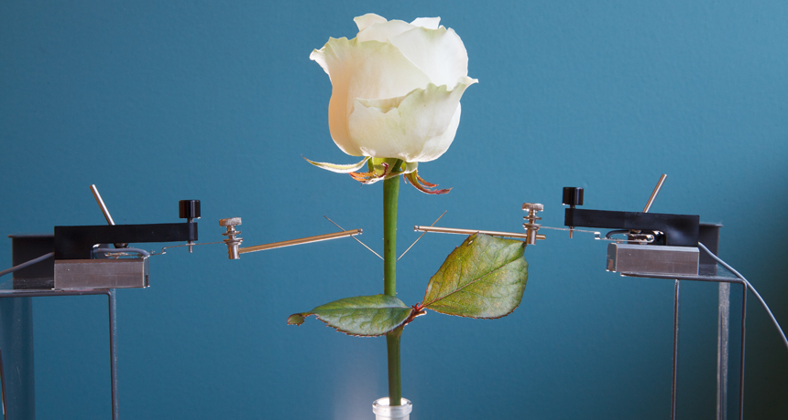
Current Event:
Cyborg Plants
- used to harness energy
- root cyborgs used to understand environment
- Could be used as sensors for farmer in crop production.

