Slide 1
Dynamics: Forces and motion in 1D and 2D
2/28/2017

Slide 2
Objectives:
Objective:
I begin to understand projectile motion.
I can analyze bad physics in a movie.
Tasks:
Movie (remember to note bad physics)

Slide 3
Question:
Question 4,5, and 6 on the packet handed out. Projectile motion and 2-d

Slide 4
ANNOUNCEMENTS:
Science Bowl practice today.
Paper on Movie due 3/9/17

Slide 5
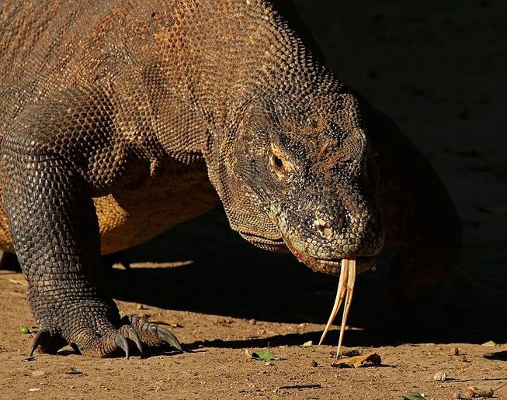
Current Event:
Dragon Blood could be the answer to anti-biotic resistance bacteria.
Komodo Dragon blood has been found to contain proteins that are able to kill some of the worst infections on Earth.
The researchers hope to develop their findings into products that could help wipe clean the slate of anti-biotics.

