Slide 1
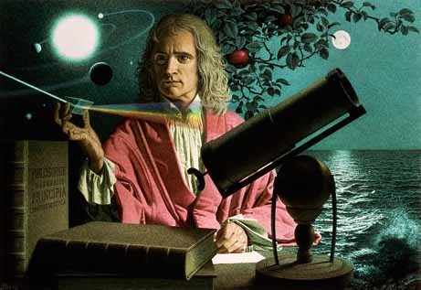
Dynamics: Forces and motion in 1D and 2D
2/21/2017

Slide 2
Objectives:
Objective:
I understand the relationship between mass and acceleration in a modified atwood machine.
Tasks:
Lab

Slide 3
ANNOUNCEMENTS:
Quiz retakes for friction available today through Thursday.
Science Bowl practice at lunch.

Slide 4
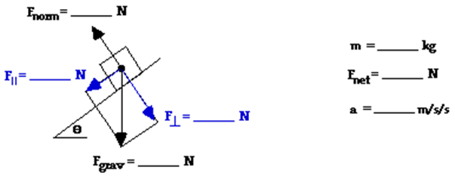
Question
Lab partners Anna Litical and Noah Formula placed a 0.500-kg glider on their air track and inclined the track at 15.0° above the horizontal. Determine the net force and acceleration of the glider along the frictionless track. Use the structure provided with the free body diagram shown below.

Slide 5
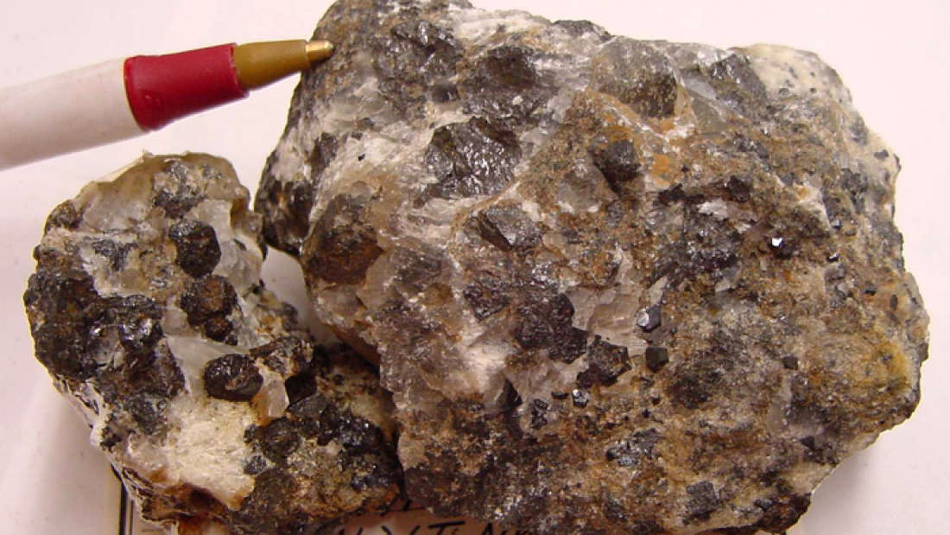
Current Event:
New Material Can Turn Light, Heat, And Movement Into Electricity All At Once
The material is a type of perovskite crystal, a family of crystals already known for being able to turn certain types of energy into electricity.
The new material, known as KBNNO (based on its chemical formula), can convert heat, visible light, and changes in pressure into electricity. Like other perovskite crystals, KBNNO is ferroelectric. The material is organized into electric dipoles, tiny compass-like needles, and when a physical change happens the dipoles misalign, creating a current.

