Slide 1
Dynamics: Forces and motion in 1D and 2D
2/15/2017

Slide 2
Objectives:
Objective:
Understand inclined planes and tension.
Tasks:
Notes
Worksheet(due Friday)
Lab Due

Slide 3
ANNOUNCEMENTS:
Quiz retakes last day today
Nothing at lunch, I have a meeting.

Slide 4
Question:
Helen is parasailing. She sits in a seat harness which is attached by a tow rope to a speedboat. The rope makes an angle of 51° with the horizontal and has a tension of 350 N. Determine the horizontal and vertical components of the tension force.
Answer:
F vert = 350 N * sin 51
F vert = 234.6 N
F horiz = 350 N * cos 51
Fhoriz = 259.8 N

Slide 5
Question:
At one moment during a walk around the block, there are four forces exerted upon Fido - a 10.0 kg dog. The forces are:
F_{app} = 67.0 N at 30.0° above the horizontal (rightward and upward) F_{norm} = 64.5 N, up F_{frict} = 27.6 N, left F_{grav} = 98 N, down
Resolve the applied force (F_{app}) into horizontal and vertical components, then add the forces up as vectors to determine the net force.

Slide 6
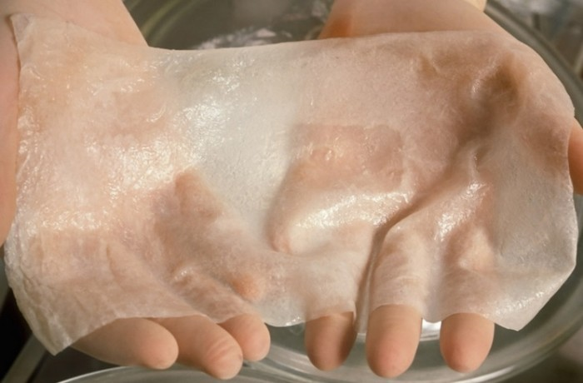
Current Event:
3-D skin printer could be headed toward human trials!

