Slide 1
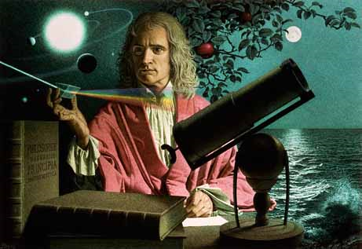
Dynamics: Forces and motion in 1D and 2D
2/13/2017

Slide 2
Objectives:
Objective:
Understand vector addition.
Tasks:
Notes
Worksheet (due Wednesday)
Lab Due tomorrow

Slide 3
ANNOUNCEMENTS:
Quiz retakes are available through Wednesday.
Grand Tour at lunch today.

Slide 4
Question:
If I gave you two coefficients for friction, .15 and .11, for the same object on the same surface, could you tell me which one was for static and which one was for kinetic friction? Which one is which and why would you give them this designation?

Slide 5
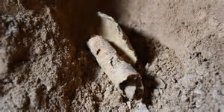
Current Event:
New Dead Sea Scrolls Cave Found!

