Slide 1
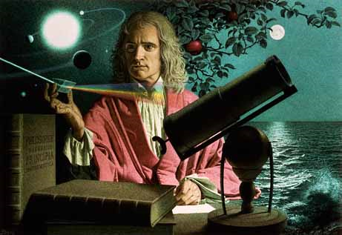
Dynamics: Forces and motion in 1D and 2D
2/9/2017

Slide 2
Objectives:
Objective:
Understand static and kinetic friction.
Understand what work means.
Tasks:
Start friction lab after demonstration

Slide 3
ANNOUNCEMENTS:
Quiz retakes are available tomorrow through next Wednesday.
Nothing at lunch today, sorry.

Slide 4
Question:
Draw a free-body diagram for the following scenario. A box is accelerating on a surface at 1.6 m/s/s. The f(w)=84N. The coefficient of kinetic friction is .1. Draw the diagram and determine the force of friction, the applied force, the normal force, and the net force.
Next determine the amount of work that would be done if the box was moved 4.9m.

Slide 5
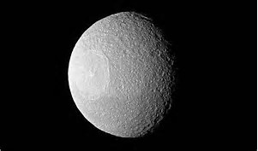
Current Event:
The first nuclear bomb test in history is helping scientists unlock secrets of how the Moon formed

