Slide 1
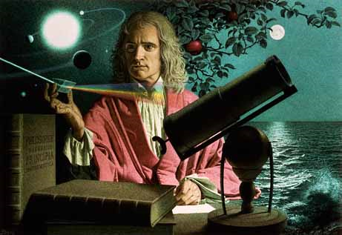
Dynamics: Forces and motion in 1D and 2D
2/8/2017

Slide 2
Objectives:
Objective:
Understand static and kinetic friction.
Understand what work means.
Tasks:
Start friction lab after demonstration

Slide 3
ANNOUNCEMENTS:
Quiz retakes are available tomorrow through next Wednesday.
Nothing at lunch today, sorry.

Slide 4
Question:
A box is given a push so that it slides across the floor. How far will it go, given that the coefficient of kinetic friction is 0.15 and the push imparts an initial speed of 3.5 m/s?

Slide 5
Answer:
F= m * a and F (f)= μ * F(normal)
For horizontal surfaces: F(n) = F(w)
So F(f) =μ * m * g and F(n)=m*a
We can combine them
μ*m*g = m*a
Since mass is on both sides of the equation we can get rid of it.
Now a=μ*g
a=.15*9.8
a=1.47m/s/s

Slide 6
Question:
Draw a free-body diagram for the following scenario. A box is accelerating on a surface at 1.6 m/s/s. The f(w)=84N. The coefficient of kinetic friction is .31. Draw the diagram and determine the force of friction, the applied force, the normal force, and the net force.
Next determine the amount of work that would be done if the box was moved 4.9m.

Slide 7
Current Event:
How the year long in space affected astronaut Scott Kelly compared to his twin (also an astronaut) who was left on Earth.
Early results in for Scott and Mark Kelly and the affect space has on the human body after a year long mission.

