Slide 1
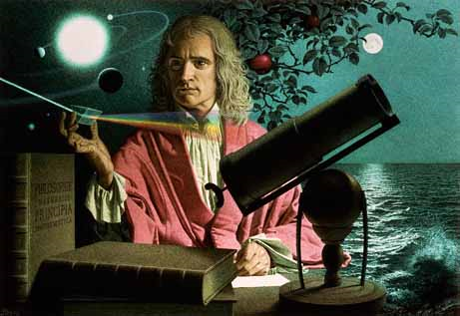
Dynamics: Forces and motion in 1D and 2D
2/7/2017

Slide 2
Objectives:
Objective:
Understand static and kinetic friction.
Tasks:
Quiz review
3.3 worksheet due
Start friction quiz after demonstration

Slide 3
ANNOUNCEMENTS:
- Science bowl practice today at lunch

Slide 4
Question:
A box is given a push so that it slides across the floor. How far will it go, given that the coefficient of kinetic friction is 0.15 and the push imparts an initial speed of 3.5 m/s?

Slide 5
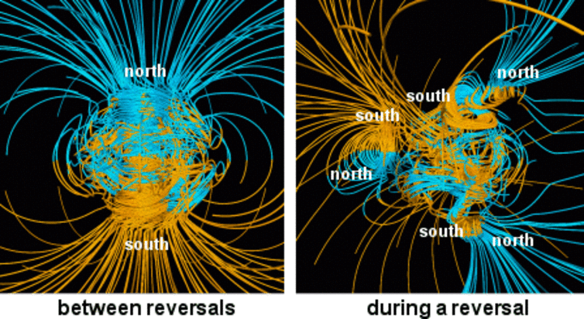
Current Event:
Does An Anomaly In The Earth’s Magnetic Field Portend A Coming Pole Reversal?
What currently has geophysicists like us abuzz is the realization that the strength of Earth’s magnetic field has been decreasing for the last 160 years at an alarming rate. This collapse is centered in a huge expanse of the Southern Hemisphere, extending from Zimbabwe to Chile, known as the South Atlantic Anomaly. The magnetic field strength is so weak there that it’s a hazard for satellites that orbit above the region – the field no longer protects them from radiation which interferes with satellite electronics.

