Slide 1
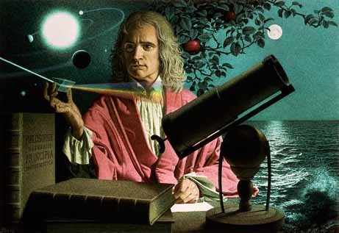
Dynamics: Forces and motion in 1D and 2D
2/3/2017

Slide 2
Objectives:
Objective:
Fully understand Newton’s Second and Third Law of Motion.
Tasks:
Notes
Worksheets due Monday.

Slide 3
ANNOUNCEMENTS:
Retakes are available from now until Today.
If you got below 75% on your test you can also do a correct and return to get to 75% (if you feel uncomfortable with retesting)
Quiz monday

Slide 4
Current Event:
Evidence of a new lost continent found.

