Slide 1
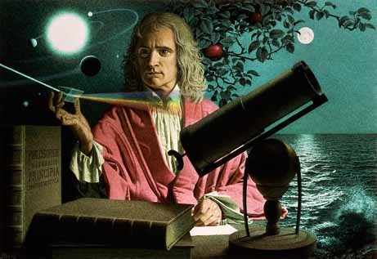
Dynamics: Forces and motion in 1D and 2D
2/2/2017

Slide 2
Objectives:
Objective:
Fully understand types of force and how to draw free-body diagrams.
Tasks:
Notes
Worksheet due tomorrow.

Slide 3
Question:
How does a seatbelt relate to Newton’s first law of motion?

Slide 4
ANNOUNCEMENTS:
Retakes are available from now until Friday.
Science Club
If you got below 75% on your test you can also do a correct and return to get to 75% (if you feel uncomfortable with retesting)

Slide 5
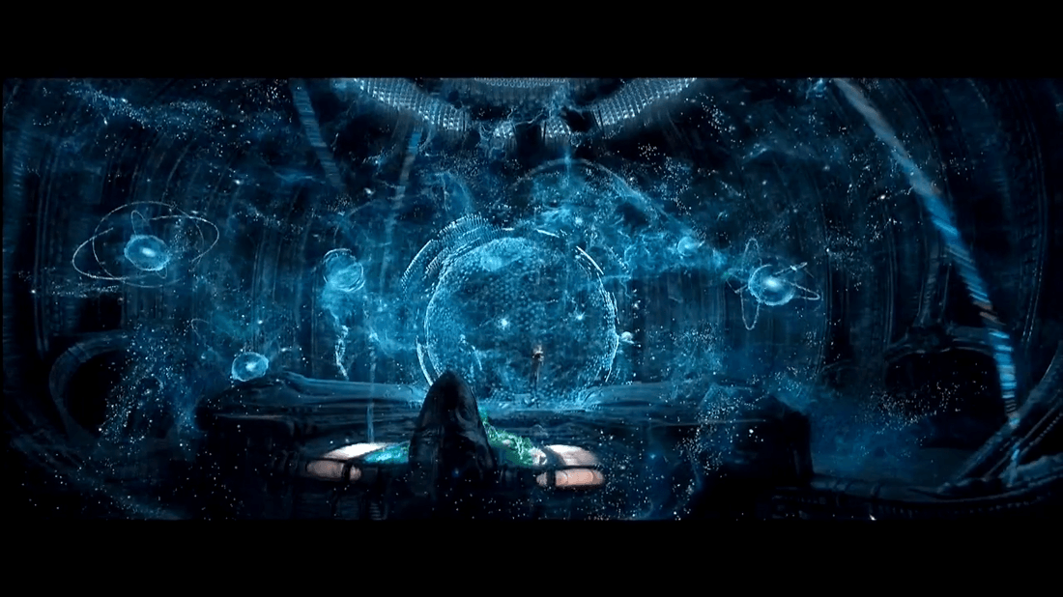
Current Event:
EXISTANCE IS A HOLOGRAM?

