Slide 1
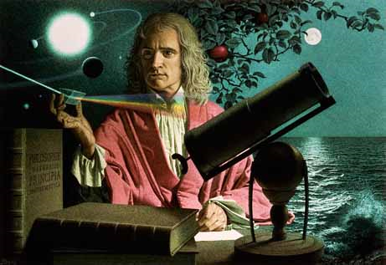
Dynamics: Forces and motion in 1D and 2D
2/1/2017

Slide 2
Objectives:
Objective:
Fully understand Newton’s 1st Law of Motion.
Tasks:
Notes on 1st Law.
Demonstrations
Worksheet due tomorrow.

Slide 3
Question:
What do you think of when you hear the word inertia? Describe it (complete sentences, you guys are old enough that I shouldn’t have to write this).

Slide 4
ANNOUNCEMENTS:
Retakes are available from now until Friday.
Grand Tour at Lunch today.
If you got below 75% on your test you can also do a correct and return to get to 75% (if you feel uncomfortable with retesting)

Slide 5
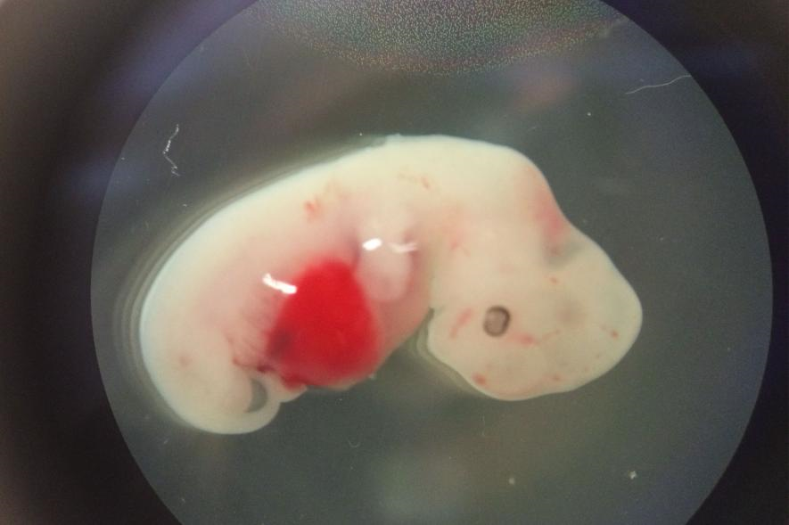
Current Event:
Human-pig hybrid
Hoping to lead to growable, transplantable organs.

