Slide 1
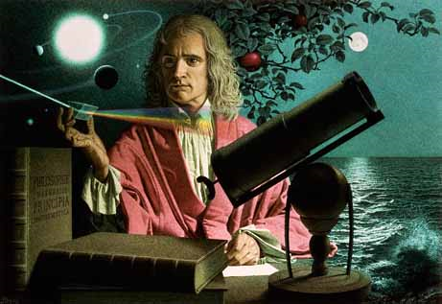
Dynamics: Forces and motion in 1D and 2D
1/30/2017

Slide 2
Objectives:
Objective:
Learn more about the grandfather of physics, Sir Isaac Newton.
Tasks:
Watch PBS documentary on Newton
Take notes on documentary.

Slide 3
Question:
What is one facet you are aware of regarding Sir Isaac Newton?

Slide 4
ANNOUNCEMENTS:
Retakes are available from now until Friday.
Grand Tour at Lunch today.

Slide 5
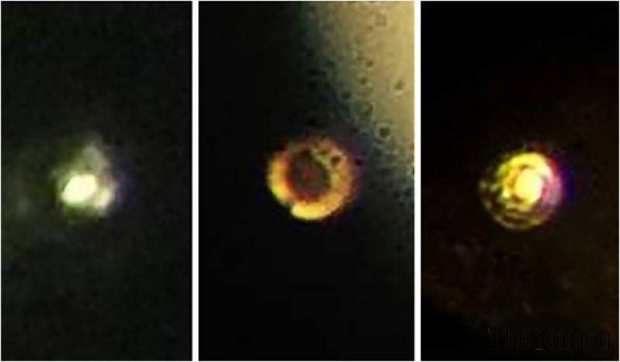
Current Event:
Scientists create metallic hydrogen on Earth for the first time.
The amount of pressure used is greater than that found in the center of the Earth.

