Slide 1
impulse, and energy!

Slide 2
Today:
Objective:
Tasks:
I am aware of what is in the next unit
Complete pre-test
You can work on your paper if you finish your pre-test

Slide 3
Question:
Complete Questions 11 and 12 in your projectile motion packet.

Slide 4
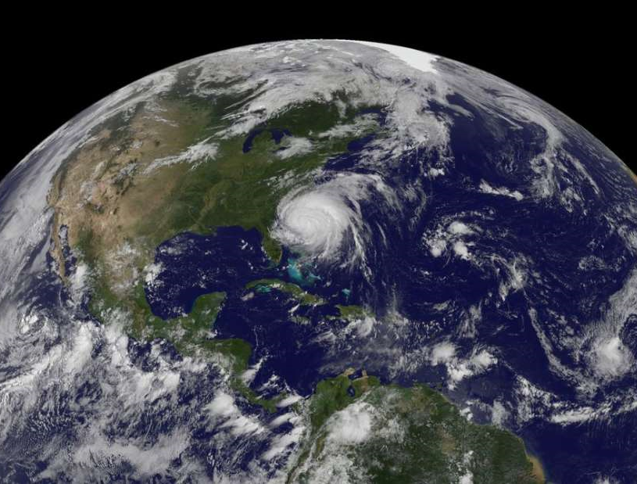
Current Event:
The music of the Earth

