Slide 1
impulse, and energy!
3/21/2017

Slide 2
Today:
Objective:
Tasks:
I understand collisions and the conservation of momentum
REVIEW

Slide 3
Announcements:
TEST THURSDAY! NO RETAKE BECAUSE OF SPRING BREAK.

Slide 4
Question:
Given a spring with a 2.6 N/cm spring constant you launch a steel ball bearing that has a mass of .25 kg. You change the position of the spring 12 cm from the natural. What is the velocity of ball when it is launched?

Slide 5
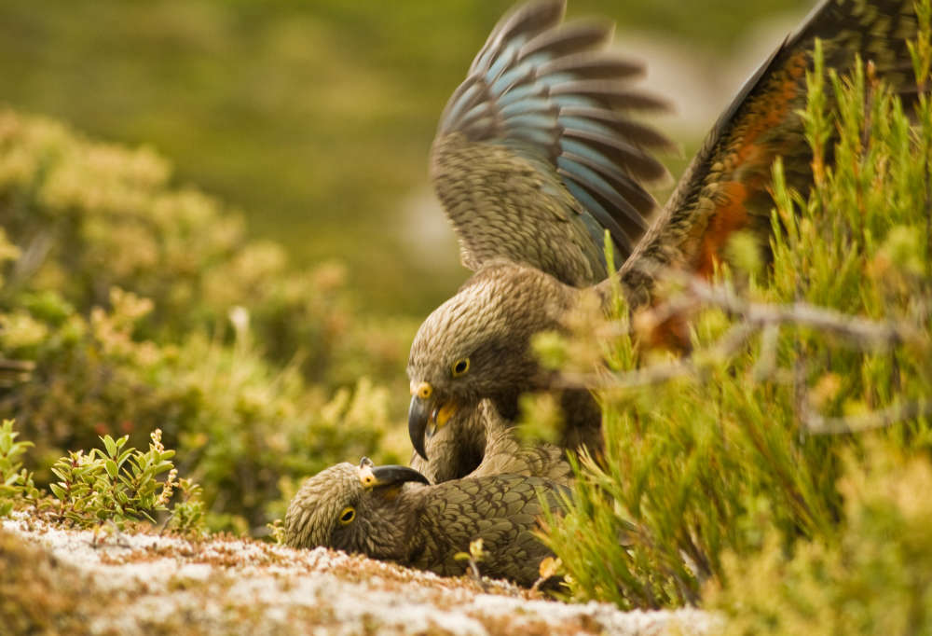
Current Event:
^{Two}
Keas have contagious laugh.
New Zealand parrot was seen to have a “laugh” that brought out playfulness in other birds.

