Slide 1
impulse, and energy!
3/20/2017

Slide 2
Today:
Objective:
Tasks:
I understand energy
Finish Energy Notes
Types of energy worksheet

Slide 3
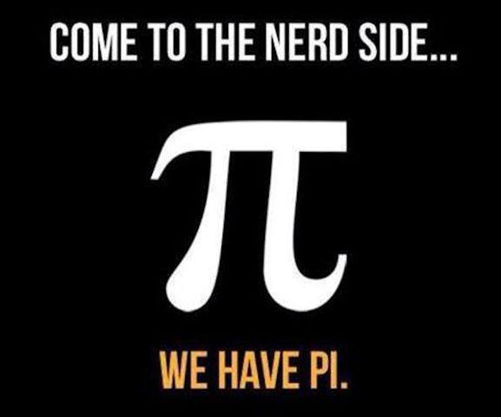
Announcements:
Test on momentum and energy on Thursday!

Slide 4
Question:
A box of mass 12 kg is displaced 500 cm at a 42 degree angle (above the horizontal) at 2 m/s/s. What is the work done on the box?

Slide 5
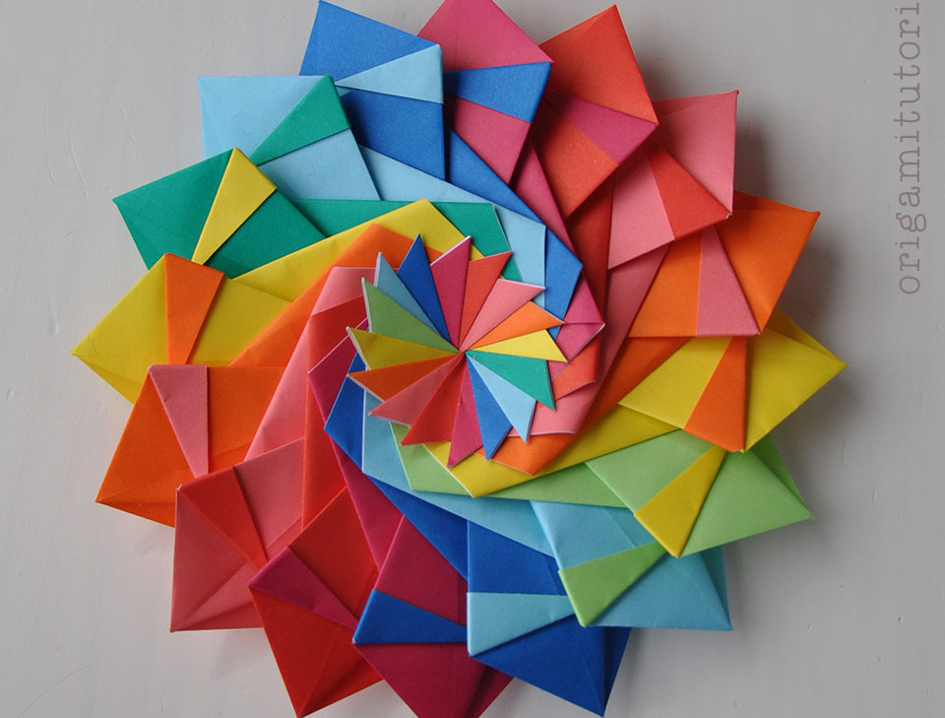
Current Event:
The physicist of folding paper.

