Slide 1
impulse, and energy!
3/14/2017

Slide 2
Today:
Objective:
Tasks:
I understand collisions and the conservation of momentum
Collision Lab

Slide 3
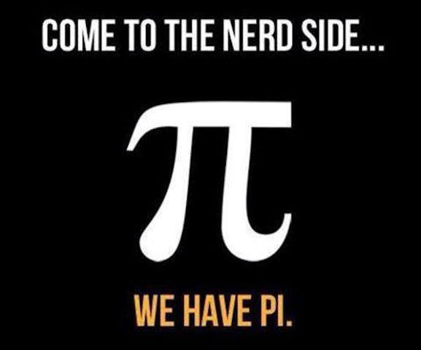
Announcements:
Pi(e) at lunch in my room (limited availability)

Slide 4
Question:
A 5.0 N force is applied to a 3.0 kg ball to change its velocity from +9.0 m/s to +3.0 m/s. What is the momentum change of the ball?
Today Find the impulse of the ball.

Slide 5
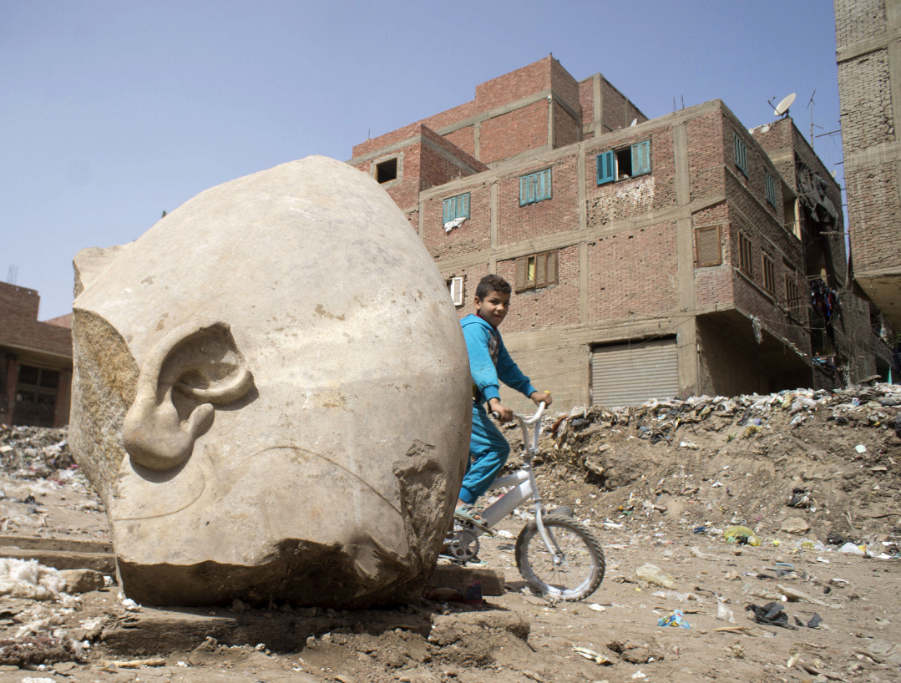
Current Event:
Ramses the second temple found in cairo slums.

