Slide 1
Electricity and magnetism
4/5/2017

Slide 2
Objectives and tasks:
Objectives:
I begin to understand electrostatics.
Tasks:
Discuss electrostatics

Slide 3
Announcements:
I moved the launch to the eleventh because of the shortened class periods on the tenth.
I have one prize for the best throw relative to size for all three class periods. I will measure the length of your throwing arm and determine your arm to distance ratio.
ROGUE ONE COMES AT LUNCH TODAY!

Slide 4
QUESTION:
WHY IS A CONDUCTOR A CONDUCTOR AND WHY IS AN INSULATOR AN INSULATOR?

Slide 5
qUESTION
How does an object become positively charged? What happens between a positively charged object and a neutral object?

Slide 6
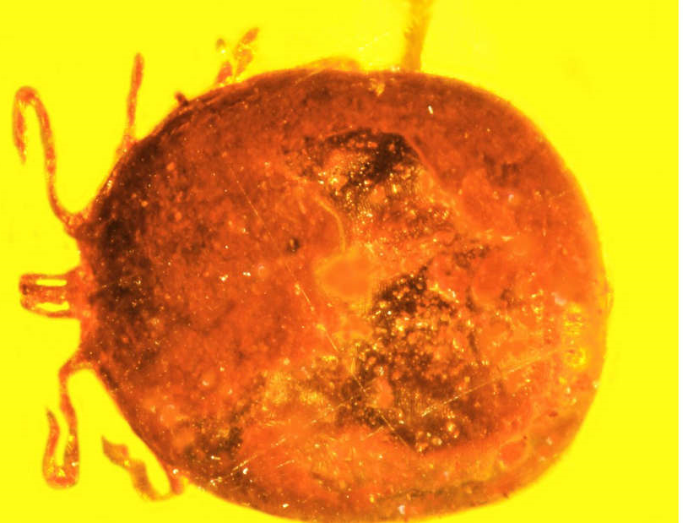
Current Event
Ancient Monkey Blood Found
Fossilized!

