Slide 1
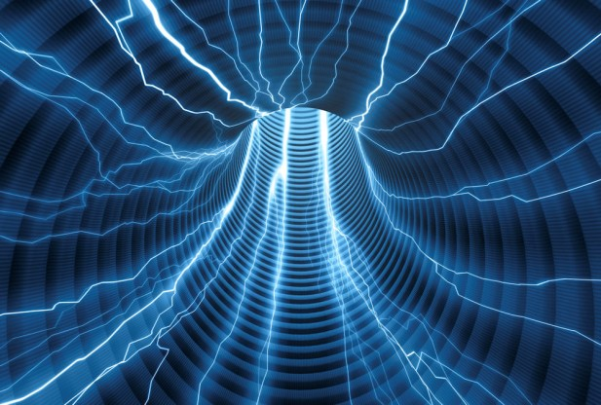
Electricity and magnetism
4/4/2017

Slide 2
Objectives and tasks:
Objectives:
I begin to understand electrostatics.
Tasks:
Discuss electrostatics

Slide 3
Announcements:
Grades are finalized by today at 12:30. If you have any questions see me today.
I moved the launch to the eleventh because of the shortened class periods on the tenth.
I have one prize for the best throw relative to size for all three class periods. I will measure the length of your throwing arm and determine your arm to distance ratio.
ROGUE ONE COMES OUT TODAY!

Slide 4
Question:
What is electricity? How does it occur?

Slide 5
QUESTION:
WHY IS A CONDUCTOR A CONDUCTOR AND WHY IS AN INSULATOR AN INSULATOR?

Slide 6

Current Event
Cell division of a tadpole
in time lapse.

