Slide 1
Electricity and magnetism
4/25/2017

Slide 2
Objectives and tasks:
Objectives:
I understand series, parallel, and combo circuits.
Tasks:
Questions and worksheets

Slide 3
Announcements:
Write up Due TODAY
Worksheet on series circuits due tomorrow.
Worksheet on parallel circuits due Thursday.

Slide 4
Question:
Charge Q acts as a point charge to create an electric field. Its strength, measured a distance 30 cm away, is 40 n/c. What is the magnitude of the electric field strength that you would expect to be measured at 60 cm awa?
Coulomb’s Law!

Slide 5
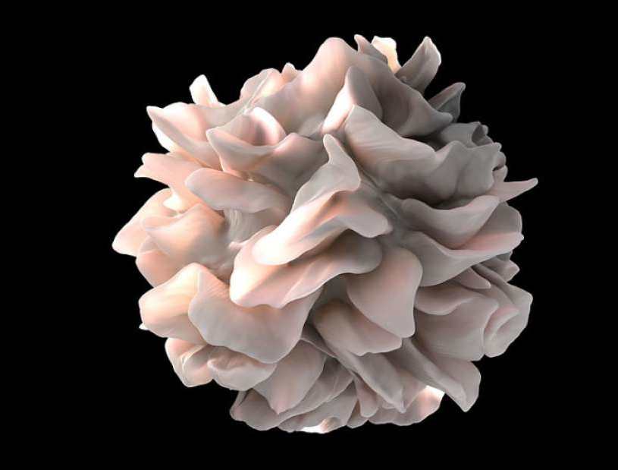
Current Event
Four new types of human blood cells discovered.

