Slide 1
Electricity and magnetism
4/24/2017

Slide 2
Objectives and tasks:
Objectives:
I understand series circuits and how to calculate V, I, and R in each
Tasks:
Finish circuits notes and play with circuits
Work on worksheets

Slide 3
Announcements:
Write up Due TOMORROW
Worksheets due today

Slide 4
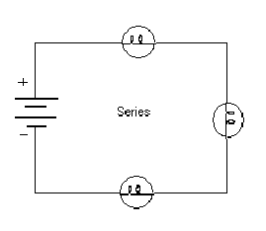
Question:
Calculate total resistance, the voltage drop for each lamp and the current in the circuit.
Battery = 90V
Lamp 1 =5 ohms
Lamp 2 = 2 ohms
Lamp 3 = 4.3 ohms

Slide 5
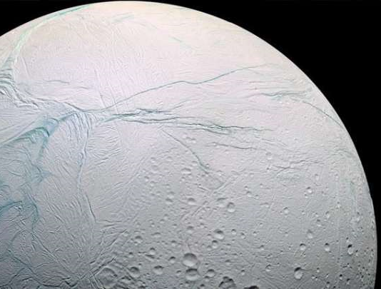
Current Event
NASA: Enceladus is able to host life

