Slide 1
Electricity and magnetism
4/20/2017

Slide 2
Objectives and tasks:
Objectives:
I to understand circuits.
Tasks:
Finish circuits notes and play with circuits
Work on worksheets

Slide 3
Announcements:
Write up Due 4/25
Worksheets due tomorrow or Monday

Slide 4
Question:
What is the electric potential energy in a circuit with 3 Ohms of resistance and 12 amps of currents?

Slide 5
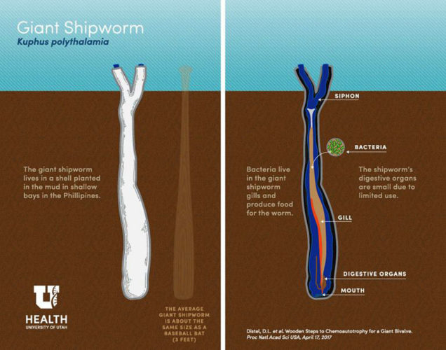
Current Event
Giant Shipworm!

