Slide 1
Electricity and magnetism
4/3/2017

Slide 2
Objectives and tasks:
Objectives:
I understand what is expected to be learned in the electricity and magnetism unit.
Tasks:
Take pre-assessment

Slide 3
Announcements:
Grades are finalized by tomorrow at 12:30. If you have any questions see me today.
I moved the launch to the eleventh because of the shortened class periods on the tenth.
I have one prize for the best throw relative to size for all three class periods. I will measure the length of your throwing arm and determine your arm to distance ratio.

Slide 4
Question:
What is electricity? How does it occur?

Slide 5
Current Event
Juno sends back stunning
Jupiter pictures!

Slide 6
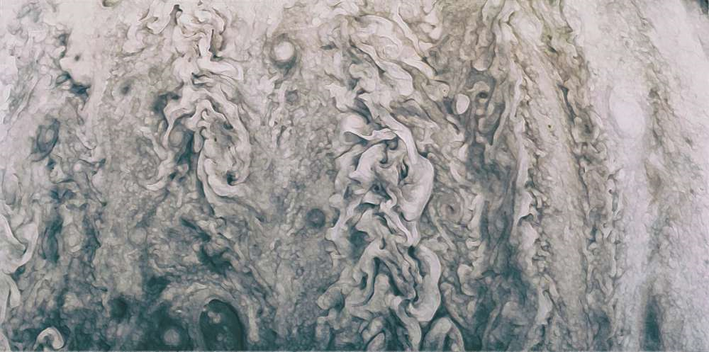

Slide 7
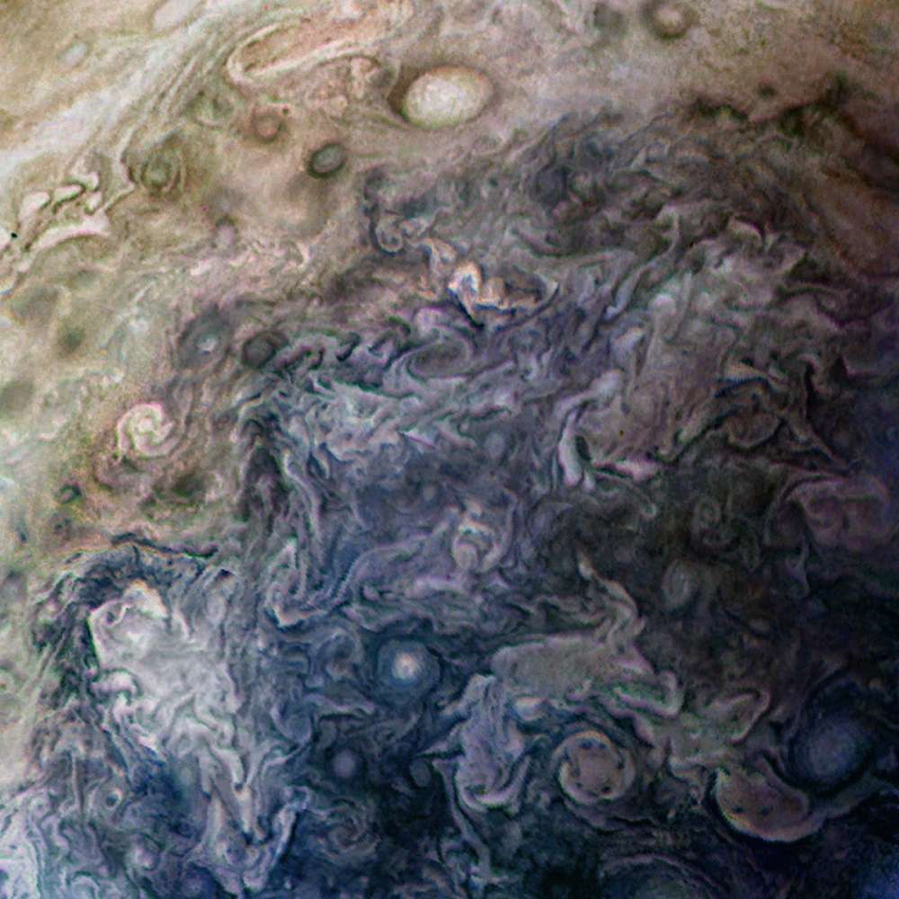

Slide 8
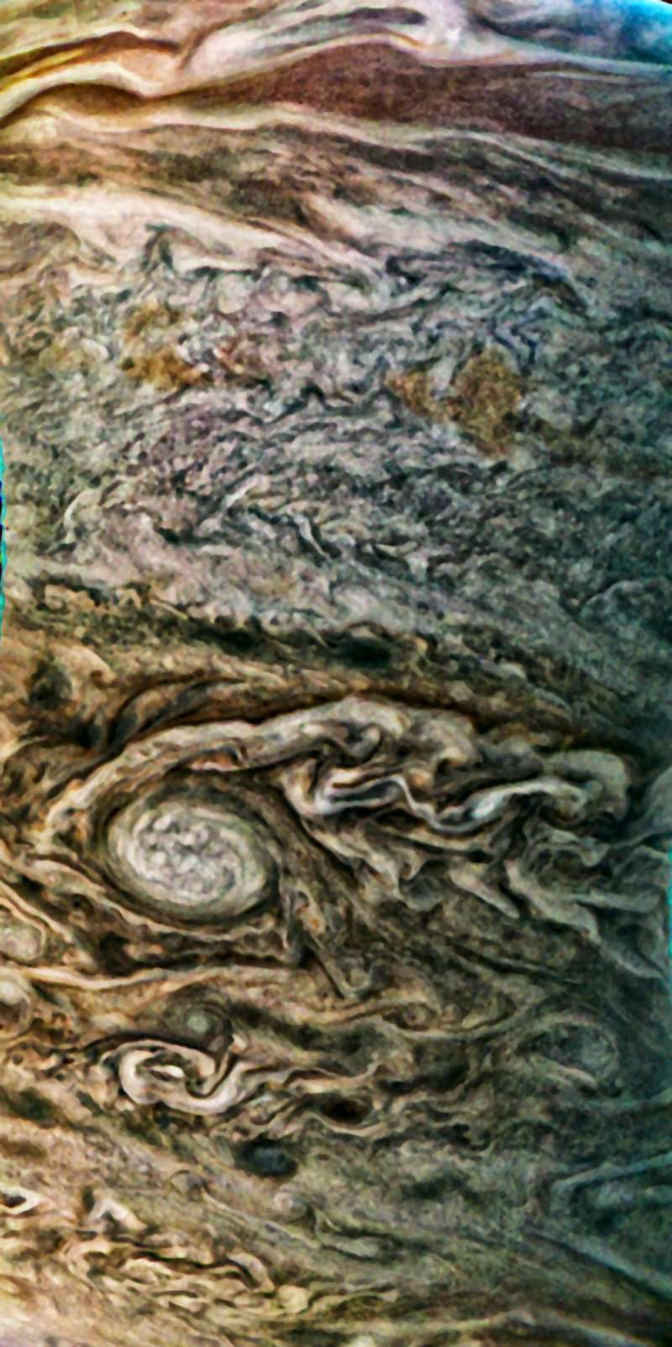

Slide 9
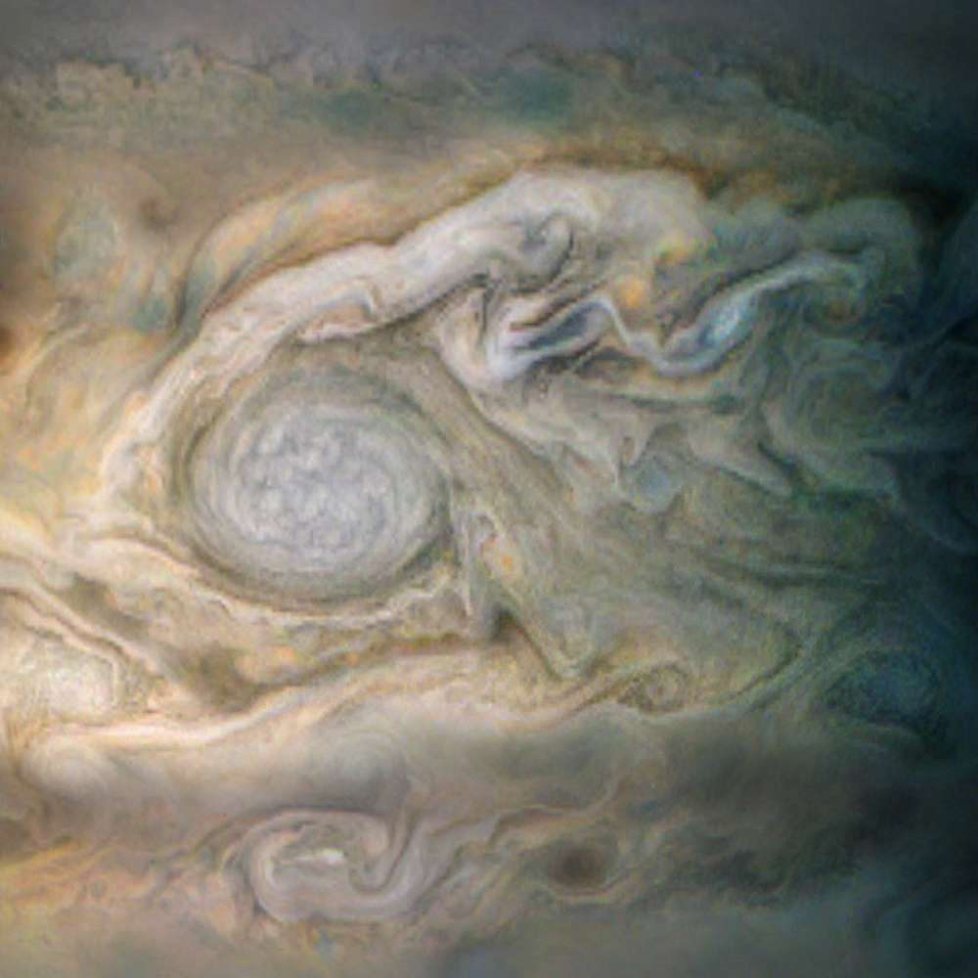

Slide 10
Juno will die sometime in 2018. nasa will plunge juno into Jupiter’s cloud layer to prevent bacterial contamination to any of its water bearing moons.

