Slide 1
Electricity and magnetism
4/19/2017

Slide 2
Objectives and tasks:
Objectives:
I to begin to understand circuits.
Tasks:
Electric potential notes
Circuit notes
worksheet

Slide 3
Announcements:
Write up due 4/25!
Prizes awarded 4/25
Quiz retake by Friday (or you can turn in the electrostatics review questions for 80%)

Slide 4
Question:
What is electric potential energy and what do we call it?

Slide 5
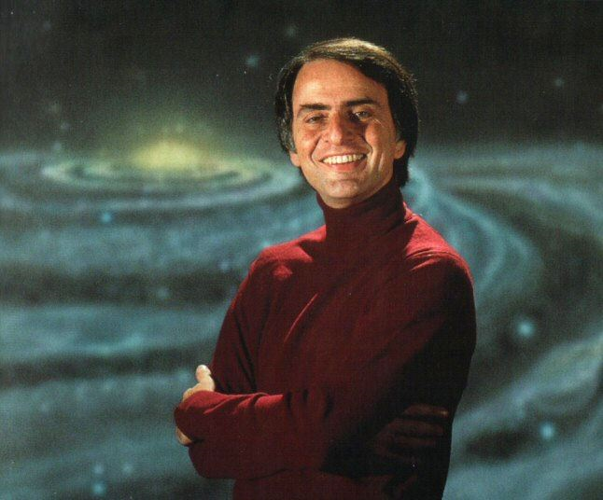
Current Event
I have two today!
We have a very close fly by of a large asteroid today! It can be seen by telescope or you can watch live video of its fly by.
Carl Sagan’s Baloney Detection kit!

