Slide 1
Electricity and magnetism
4/18/2017

Slide 2
Objectives and tasks:
Objectives:
I to begin to understand circuits.
Tasks:
Electric potential notes
Circuit notes
worksheet

Slide 3
Announcements:
I got nothing

Slide 4
Question:
What makes a circuit?

Slide 5
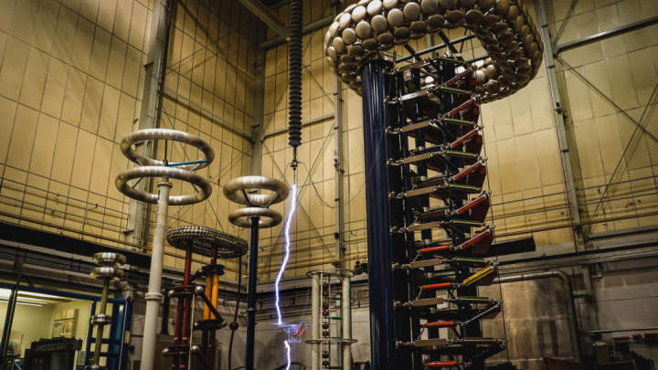
Current Event
Drones Battle with Lightning!

