Slide 1
Sound: The Science of Music
Chapter 15

Slide 2
Superposition Principle: Adding Waves
Two waves that hit each other will interact by adding or subtracting amplitude (energy) from each other.
If two people on opposite ends of a slinky sent a wave from each end of the slinky on the same side when the two waves meet the pulses will combine making a bigger amplitude.
When two waves that have positive amplitudes interact the combined wave is the sum of the two combining waves. This is called constructive interference.

Slide 3
Example of Constructive Interference
Notice that the waves are in phase.

Slide 4
Destructive Interference:
Waves that are out of phase (may have same period). This means that their crests and troughs align opposite of each other.
When these waves meet the amplitude is the difference between the two waves.

Slide 5
Example of Destructive Interference
Notice that the waves are 180 degrees out of phase but that the amplitudes are not the same.

Slide 6
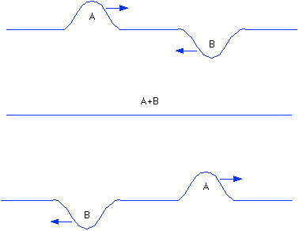
More Destructive Interference
When two waves meet that are 180 degrees out of phase but have the same amplitude the waves will cancel each other out.
A medium cannot undergo compression and rarefaction (expansion) at the same time, so they equal no motion

Slide 7
What is Sound?
Sound is the movement of compression waves that hit our ears.
Compression waves are longitudinal waves.
Compression waves consist of high and low pressure areas.
Remember that waves are movements of energy not matter this means that air molecules vibrate back and forth but they do not travel anywhere.

Slide 8
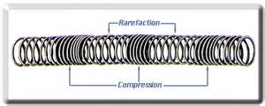
Compression and Rarefaction Waves

Slide 9
Compression and Rarefaction in Sound Waves

Slide 10
What does a graph of this look like?

Slide 11
Sound Waves
All sound waves need a medium to travel through.
What is a medium?
A something or material to travel through.
Is there sound in space?
NO! Space is silent!

Slide 12
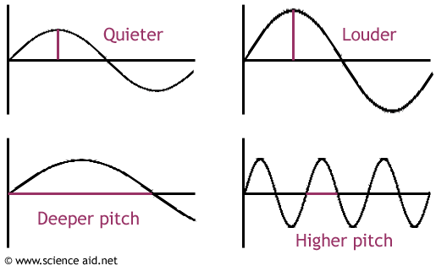
Frequency in Sound Waves
Frequency is Pitch in sound.
The higher the frequency the higher the pitch.

Slide 13
Frequency of Instruments

Slide 14
Infrasonic and Ultrasonic
Infrasonic: those sounds that are too low to hear.
Very low, very bass sounds can travel very far distances and can penetrate materials easier.
This is why we hear bass from passing sound systems the most, as they can penetrate obstacles easier.
Can you name other instances of infrasonic sound being used?
Ultrasonic: are frequencies above human hearing range.
We can hear up to about 20,000Hz.
Can you name an instance of ultrasonic sound being used?

Slide 15
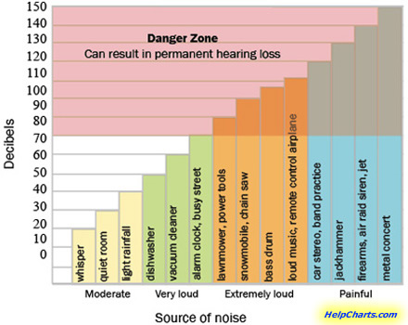
Amplitude and Sound Waves
Amplitude is the loudness of sounds.
Loudness is measure in decibels (dB)
Higher amplitude = louder sound
It takes more energy to create higher amplitudes thus it takes more energy to create louder sounds.

Slide 16
Changes in Loudness
When the loudness of a sound increases by a only 10 decibels we hear it as twice as loud.
When a sound goes from 60dB to 70dB we hear the sound twice as loud as when it was at 60 dB.
When the loudness of a sound decreases by only 10 decibels we hear it as ½ as loud.
When a sound goes from 50 dB to 40 dB we hear the sound as ½ as loud.

Slide 17
The Speed of Sound
What can change the speed of sound?
The medium
Rank the states of matter from least fast to most fast in regards to sound speed.
Gas, Liquid, Solid
Temperature also plays a role in how fast sound travels.
Generally higher temperatures mean faster sound.
Density also plays a role.
Generally denser material propagate sound faster.

Slide 18
Supersonic:
Motion that is faster than sound!
We measure speeds in planes that are faster than the speed of sound in the term Mach.
Mach 1 is 1 times the speed of sound.
Mach 2 is 2 times the speed of sound.
Sonic Boom:
A sonic boom is caused by an object breaking the sound barrier, or the speed of sound.

