Slide 1
acceleration vs time graphs

Slide 2
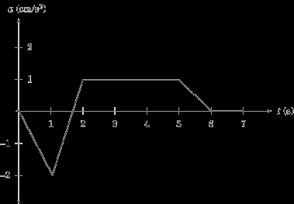
What they tell us
Information about acceleration and velocity.
The change in velocity in a given time interval is equal to the area under the graph.

Slide 3
Summary of rules for reading graphs
1. The slope on a given graph is equivalent to the quantity we get by dividing the y-axis by the x-axis. For instance, the y-axis of a position vs. time graph gives us displacement, and the x-axis gives us time. Displacement divided by time gives us velocity, which is what the slope of a position vs. time graph represents.
2. The area under a given graph is equivalent to the quantity we get by multiplying the x-axis and the y-axis. For instance, the y-axis of an acceleration vs. time graph gives us acceleration, and the x-axis gives us time. Acceleration multiplied by time gives us the change in velocity, which is what the area between the graph and the x-axis represents.

Slide 4
Summary chart
Graph | Slope | Area under the graph
Position vs. time | Velocity | -----------------
Velocity vs. time | Acceleration | Displacement
Acceleration vs. time | ------------------ | Change in velocity

